Slide 1
Demographic Bias in Human Cell Studies
Updated January 13, 2017

Slide 2
Gender bias in lung cancer research

Slide 3
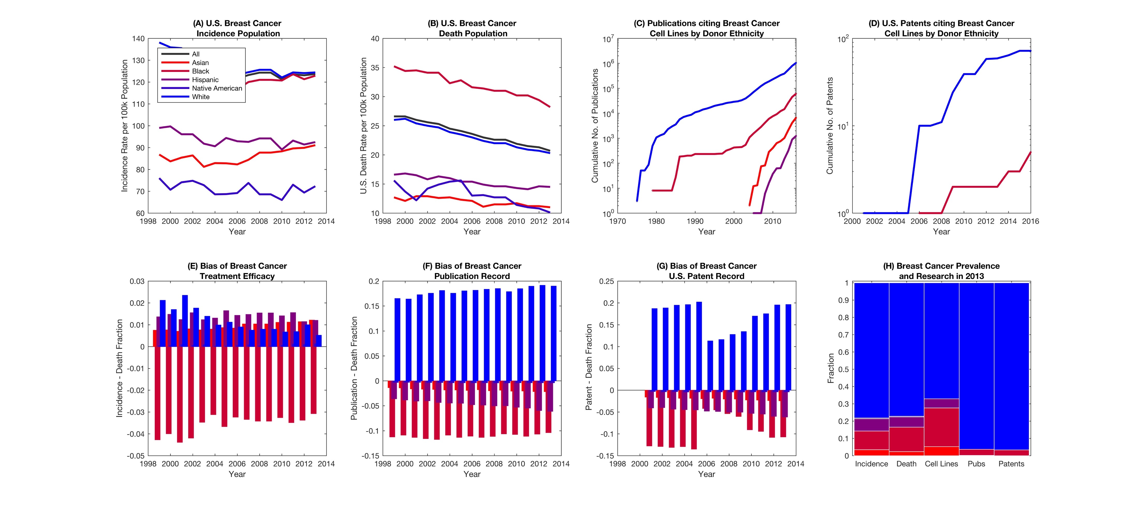
Breast Cancer

Slide 4
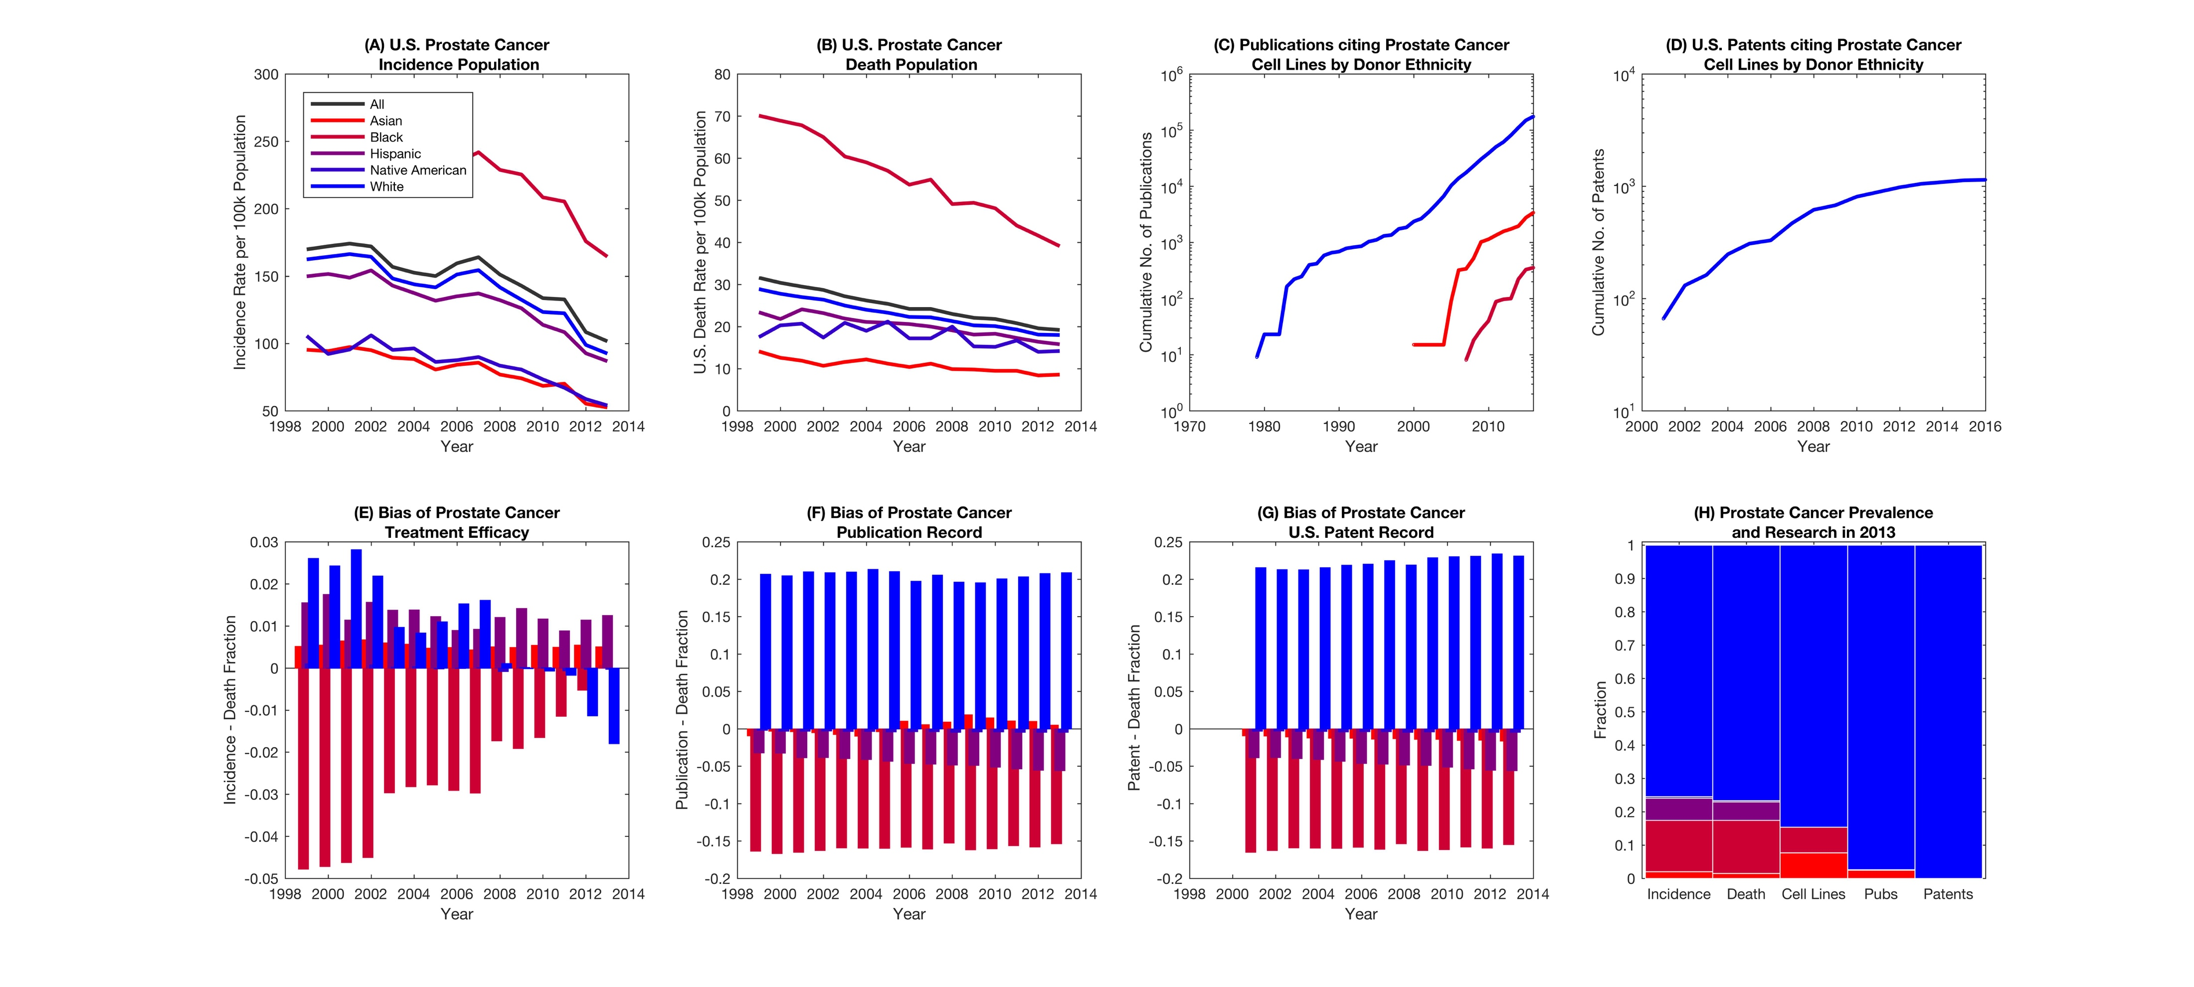
Prostate Cancer

Slide 5
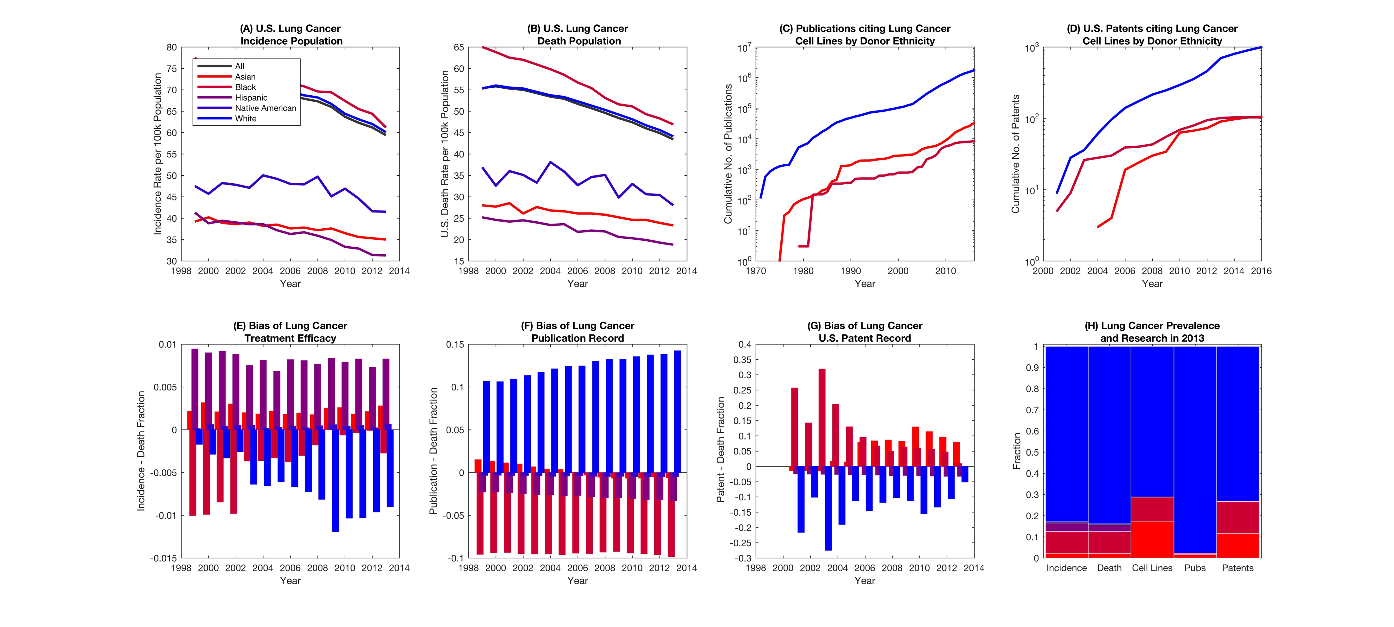
Lung Cancer

Slide 6
Old Slides

Slide 7
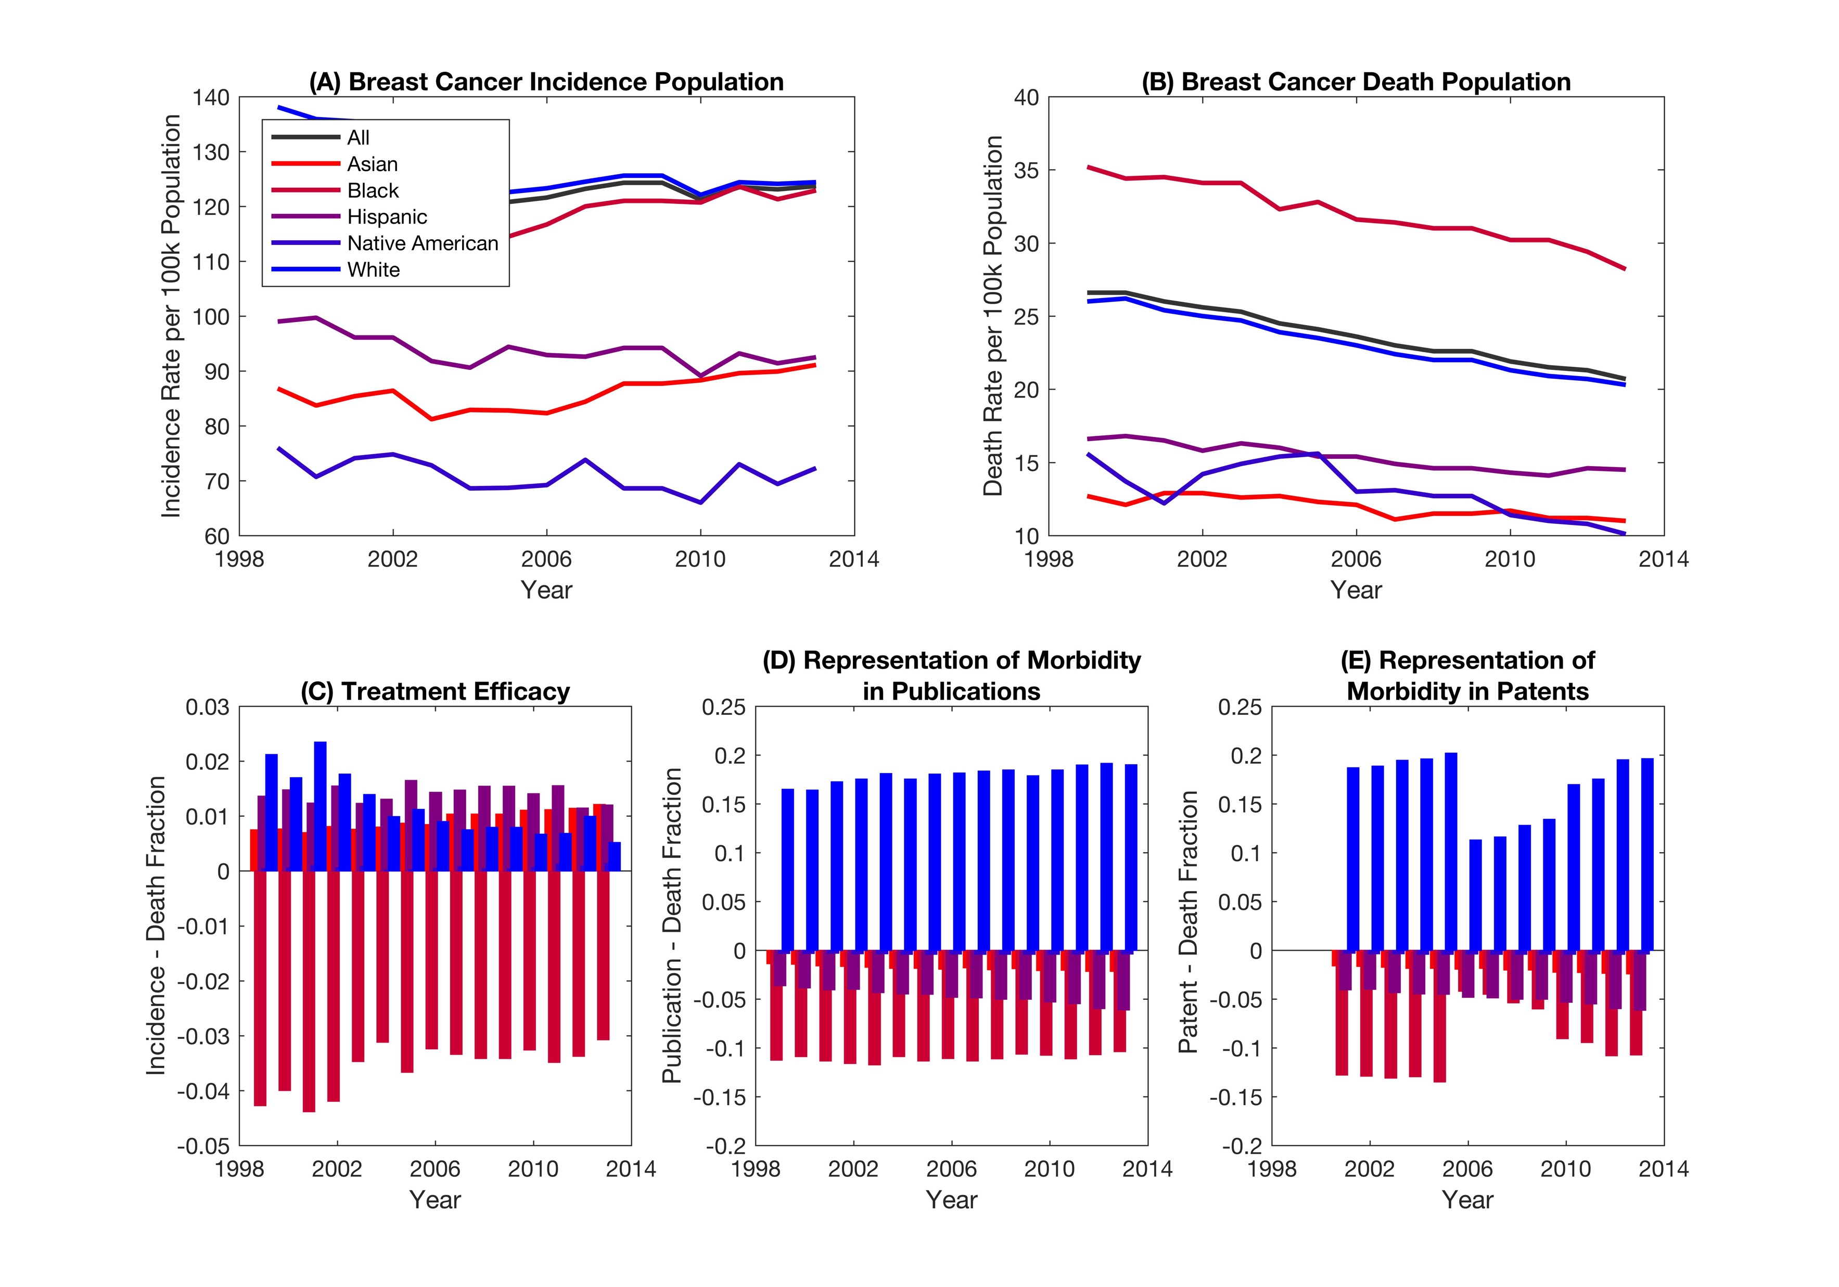
Breast cancer

Slide 8
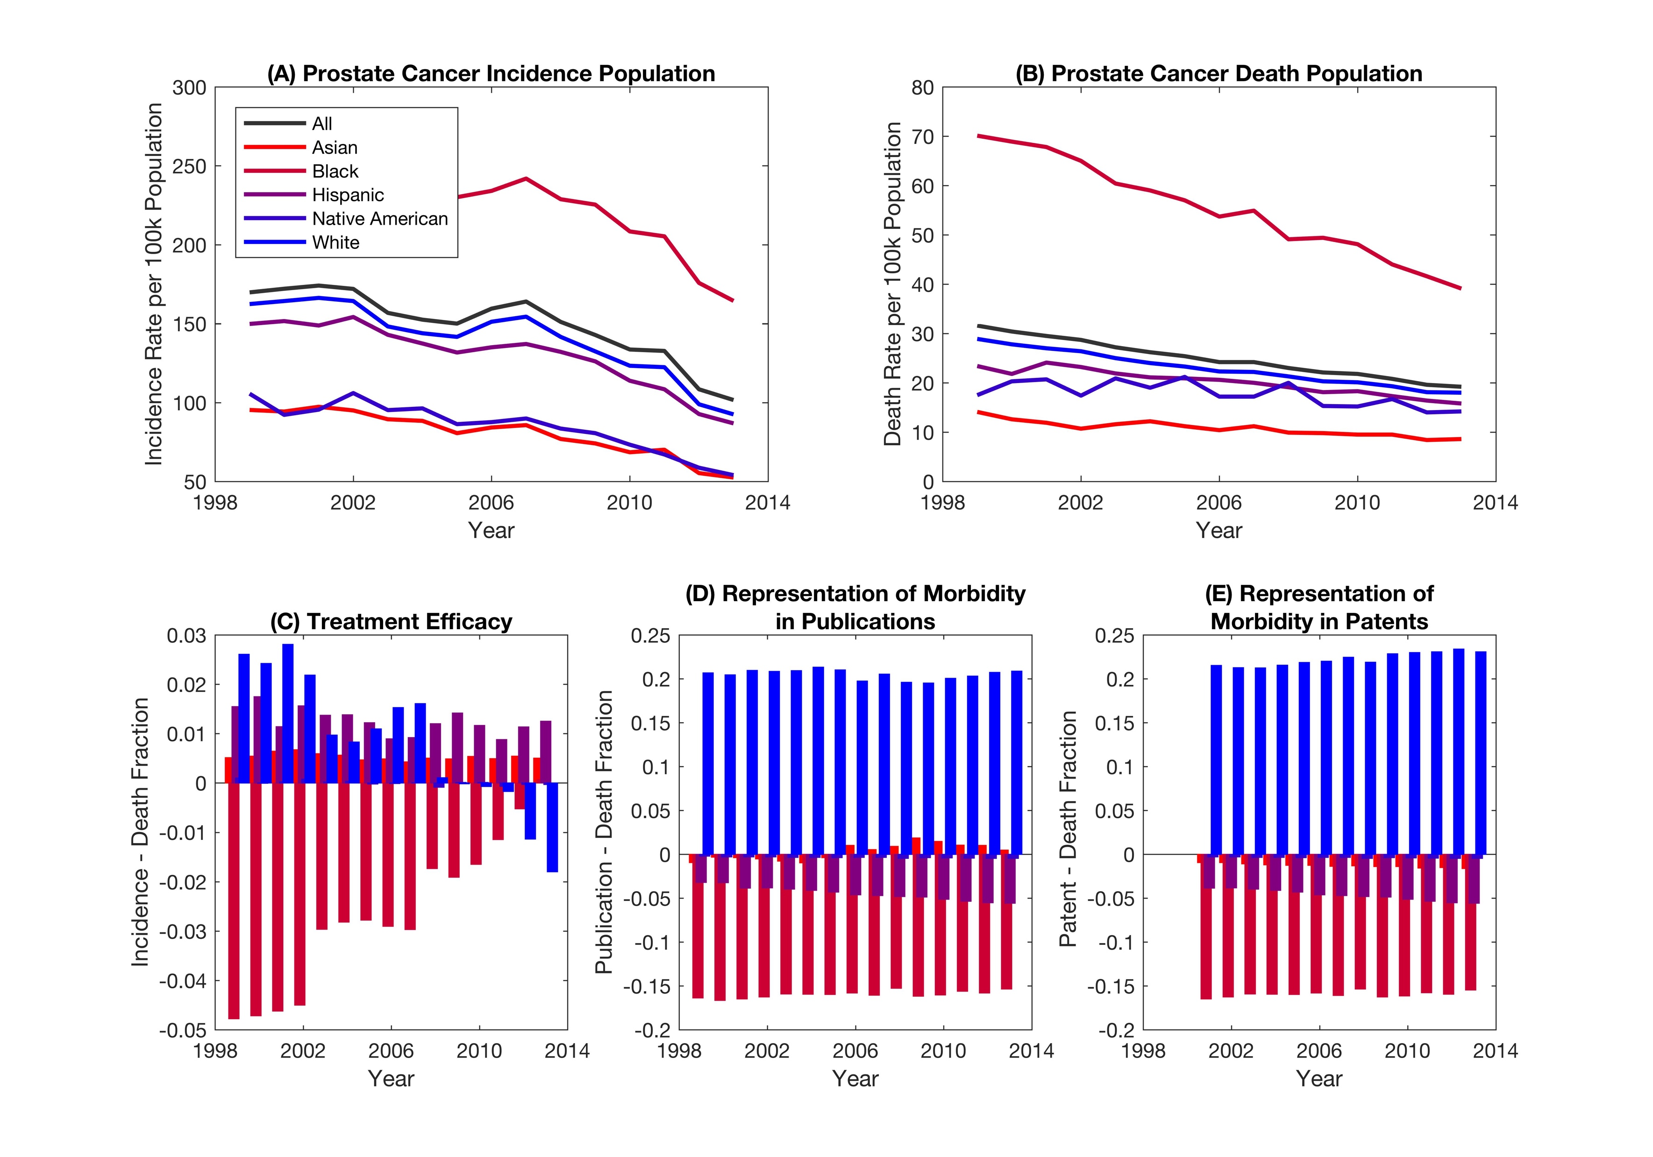
Prostate cancer

Slide 9
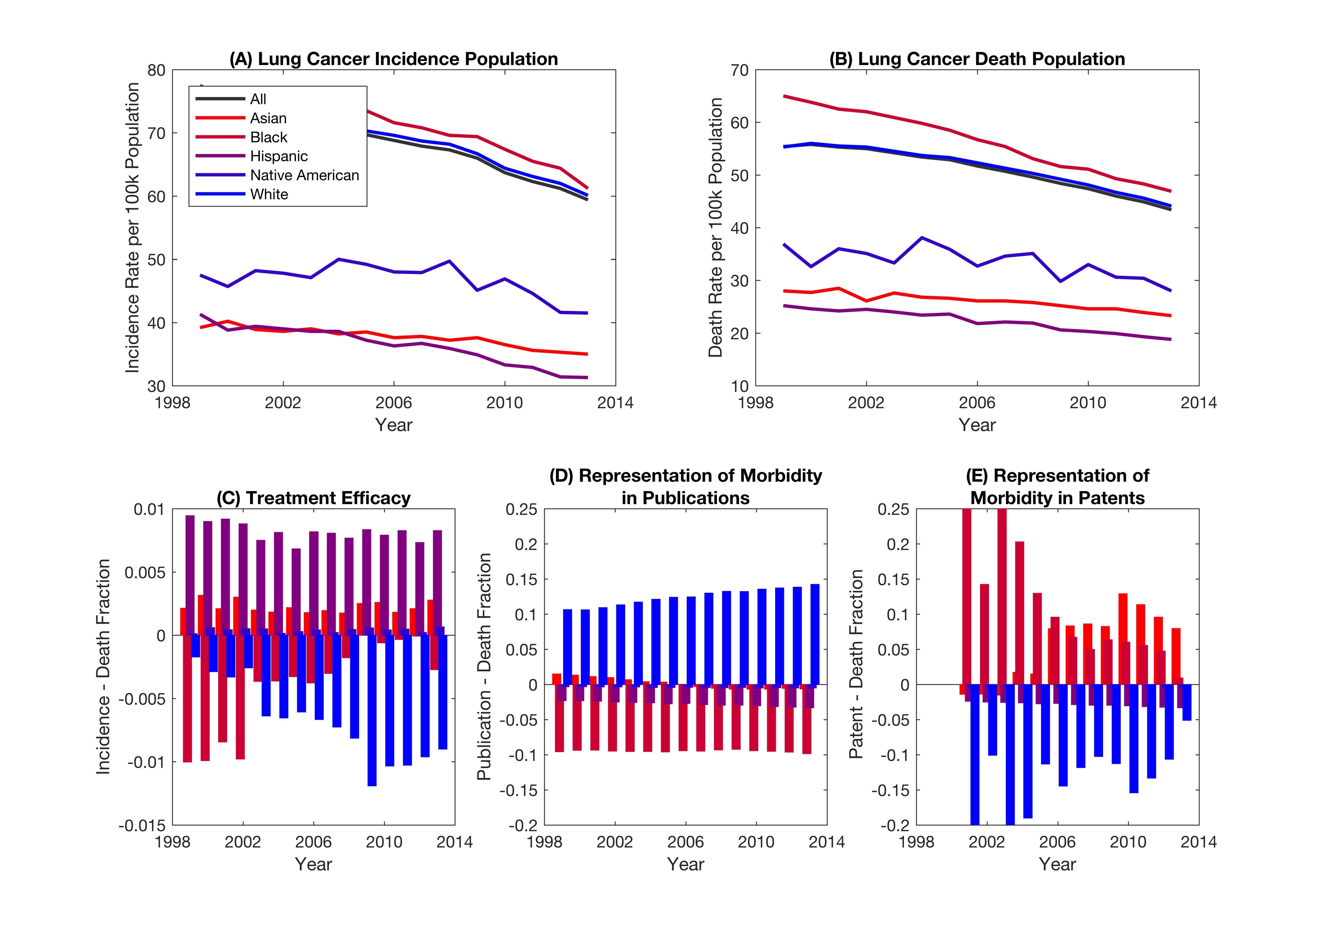
Lung cancer

Slide 10
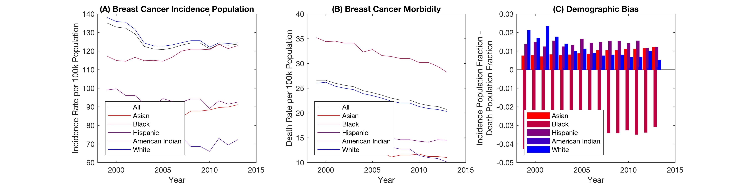
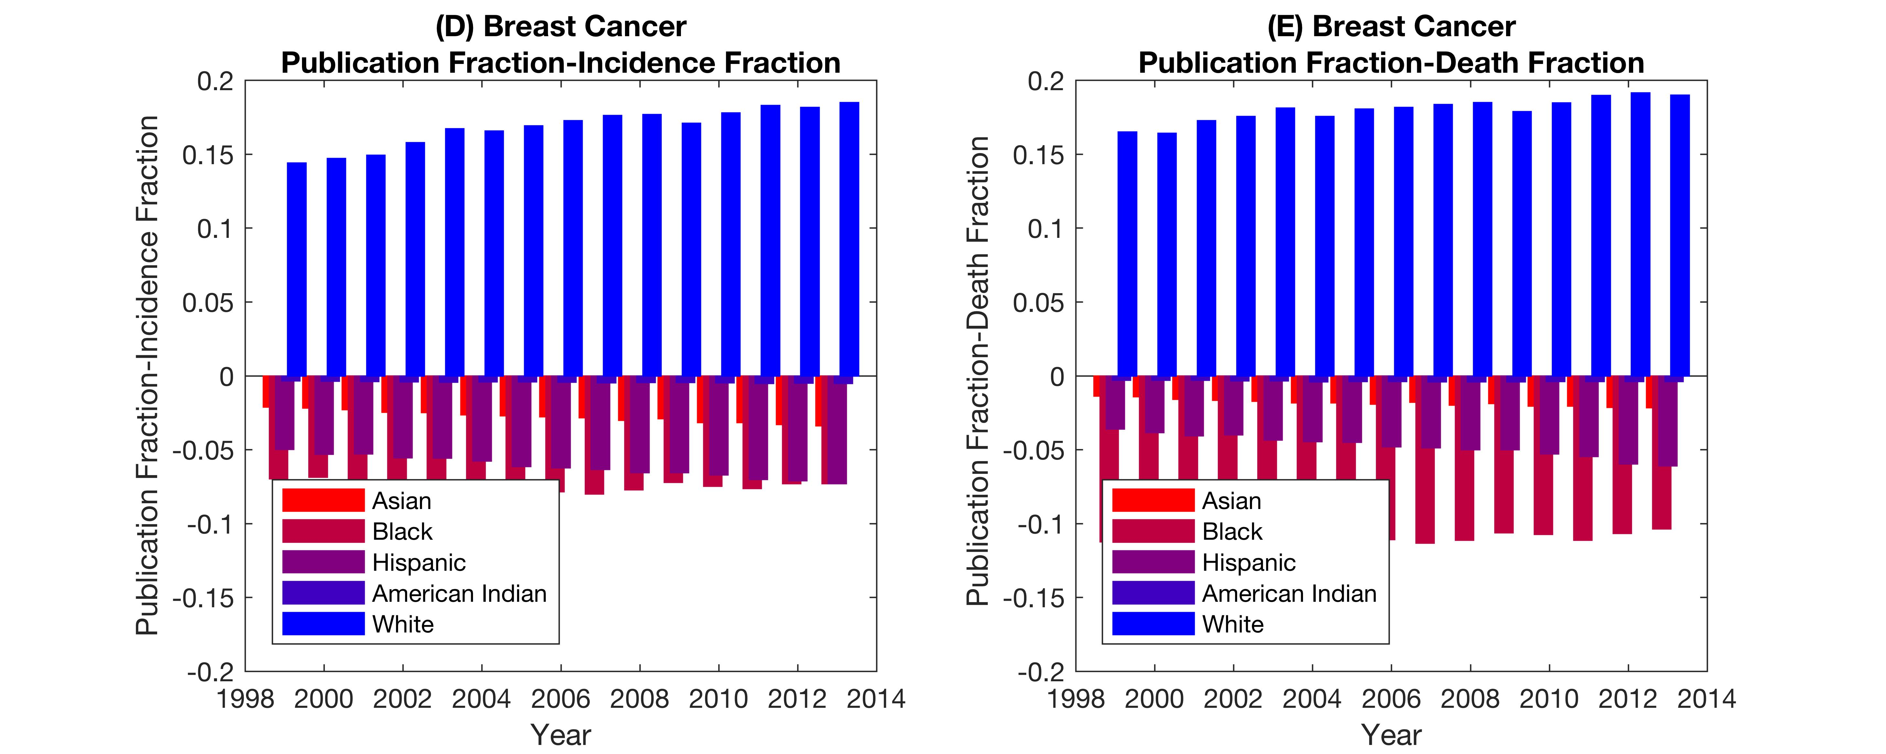
Breast Cancer

Slide 11
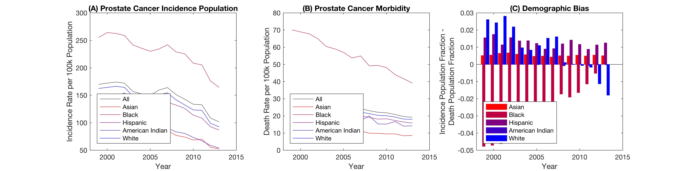
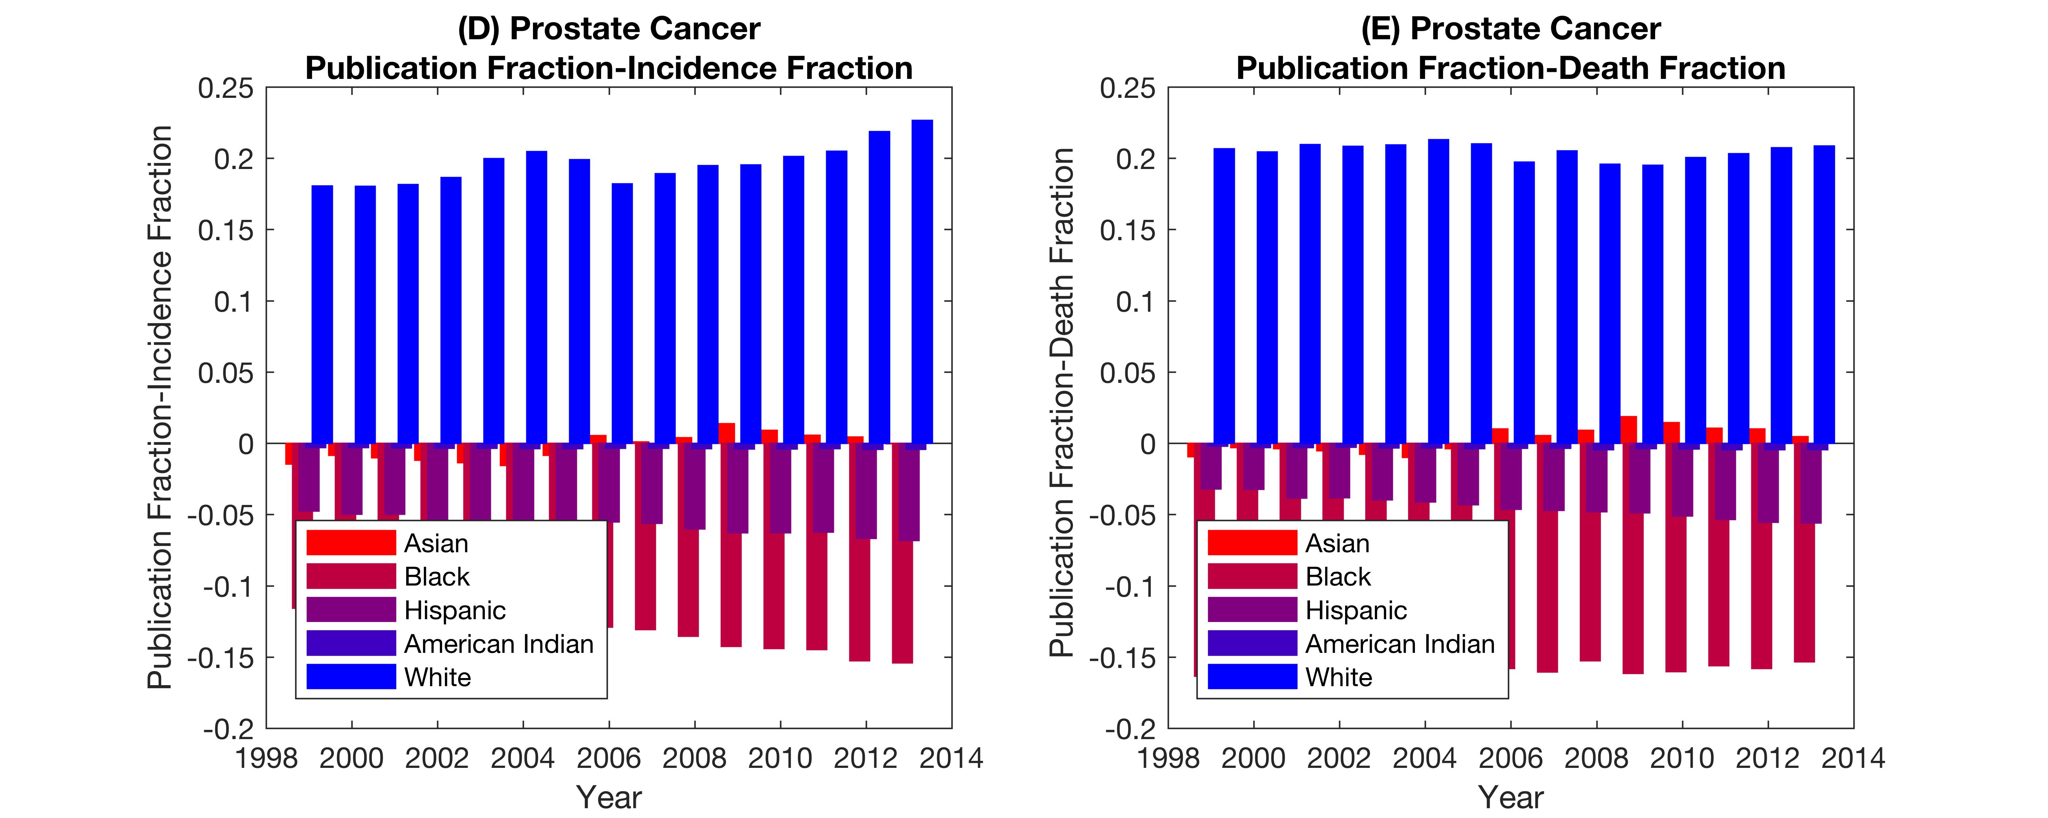
Prostate Cancer

Slide 12
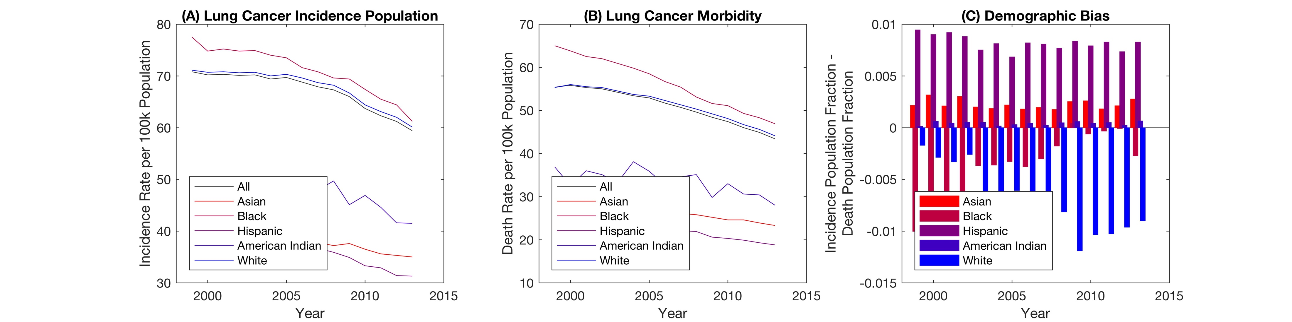
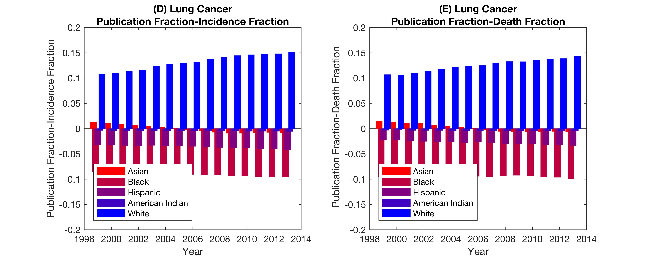
Lung Cancer

Slide 13
Objective
Measure the demographic bias in breast cancer research using human cell lines.

Slide 14
Query Design
List of cell lines
Full catalog of cell lines available from a major commercial supplier.
Contaminated cell line list
Full catalog of breast and prostate cell lines from second major commercial supplier.
Nomenclature
Each cell line name includes space before and after
Interchangeable characters of “ “ OR “/” OR “(“ OR “)” OR “.”
False positives by partial matching?
Rerun the list of cell lines for string matching against medline and patent database
Identify the cell lines to cover 80% of database
Finalize cell line list

Slide 15
Query flow
22,359,026 entries in medline.abstract
Number of documents with the following MeSH terms (371,686)
, that were published in a valid journal
Stem Cells
Hematopoietic Stem Cells
Hematopoietic Stem Cell Transplantation
Stem Cell Transplantation
Embryonic Stem Cells
Neoplastic Stem Cells
Mesenchymal Stem Cell Transplantation
Pluripotent Stem Cells
Tumor Stem Cell Assay
Neural Stem Cells
Stem Cell Factor
Prostatic Neoplasms
Breast Neoplasms
Lung Neoplasms
Hematopoietic Stem Cell Mobilization
Induced Pluripotent Stem Cells
Adult Stem Cells
Peripheral Blood Stem Cell Transplantation
Multipotent Stem Cells
Cord Blood Stem Cell Transplantation
Stem Cell Niche
Embryonal Carcinoma Stem Cells
Stem Cell Research
Fetal Stem Cells
Totipotent Stem Cells
Download full-text documents from ScienceDirect and PubMed Central: 80,711
How many cell lines occur in the texts?:
51,936 cell lines in 22,928 documents
(in medline.cell_docs)

Slide 16
Data Analysis
Grouping
Group by ethnicity, disease, gender, contamination, year
Time line of when cell lines are available – not disease specific
MatLab code
Figure
General (Inci – Rep in Pub) AND (Morb – Rep in Pub)
General (Inci – Rep in Pat) AND (Morb – Rep in Pub)
Breast (Inci – Rep in Pub) AND (Morb – Rep in Pub)
Breast (Inci – Rep in Pat) AND (Morb – Rep in Pub)
Prostate (Inci – Rep in Pub) AND (Morb – Rep in Pub)
Prostate (Inci – Rep in Pat) AND (Morb – Rep in Pub)
Lung (Inci – Rep in Pub) AND (Morb – Rep in Pub)
Lung (Inci – Rep in Pat) AND (Morb – Rep in Pub)

Slide 17
Manuscript
Written
Rationale – define discrepancy in efficacy of medical treatment along between demographic groups
Justification to examine intrinsic cell properties of different demographics as part of disease models
Background: Usefulness and history of cell models
Methodology to build query and analysis
Describe bias metric
Describe figure
Relevance: Identify stakeholders: funding bodies, researchers, medical professional implementing care. Critical for future medical advances, especially with personalized medicine and more complex tissue engineering models.

Slide 18
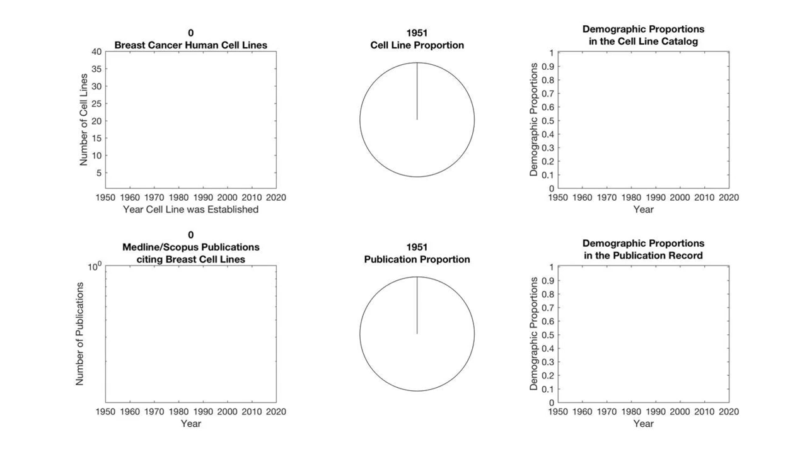
Cell Line and Publication Counts: Breast Cancer Cell Lines

Slide 19
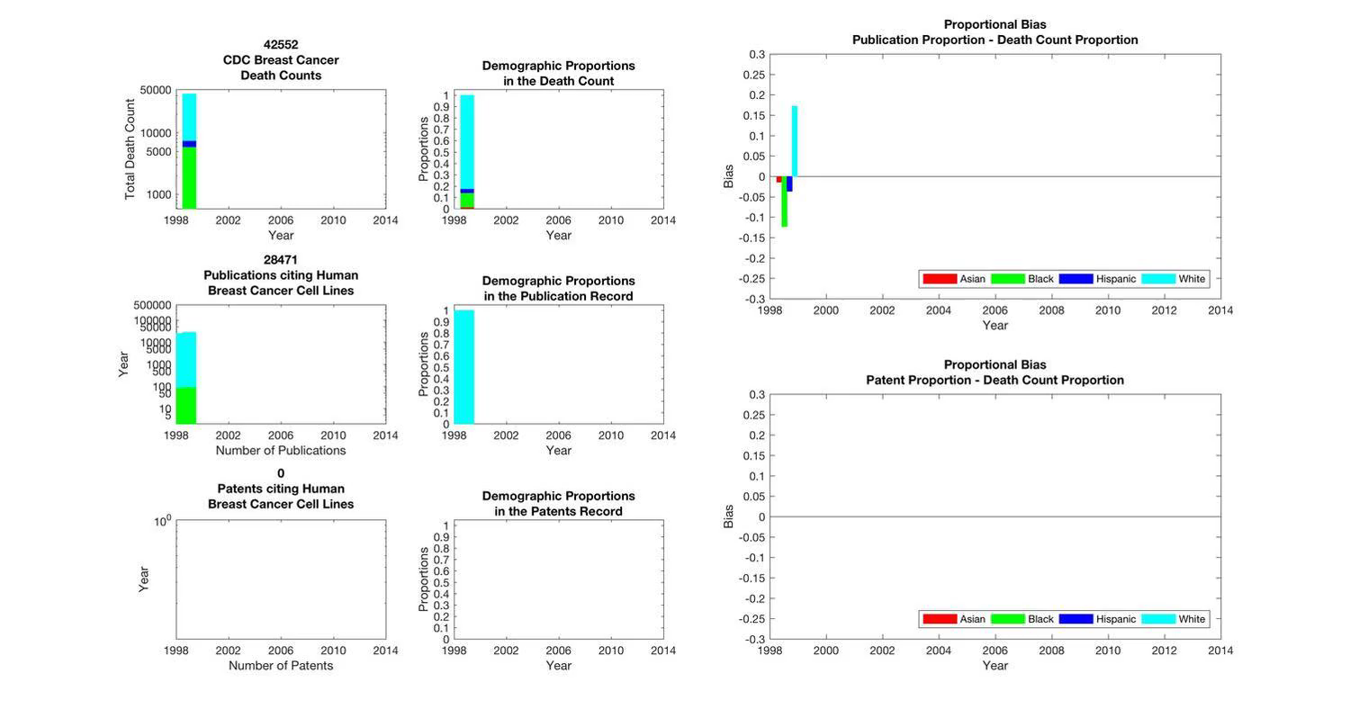
Measuring the bias in publications and patents, compared to CDC death counts

Slide 20
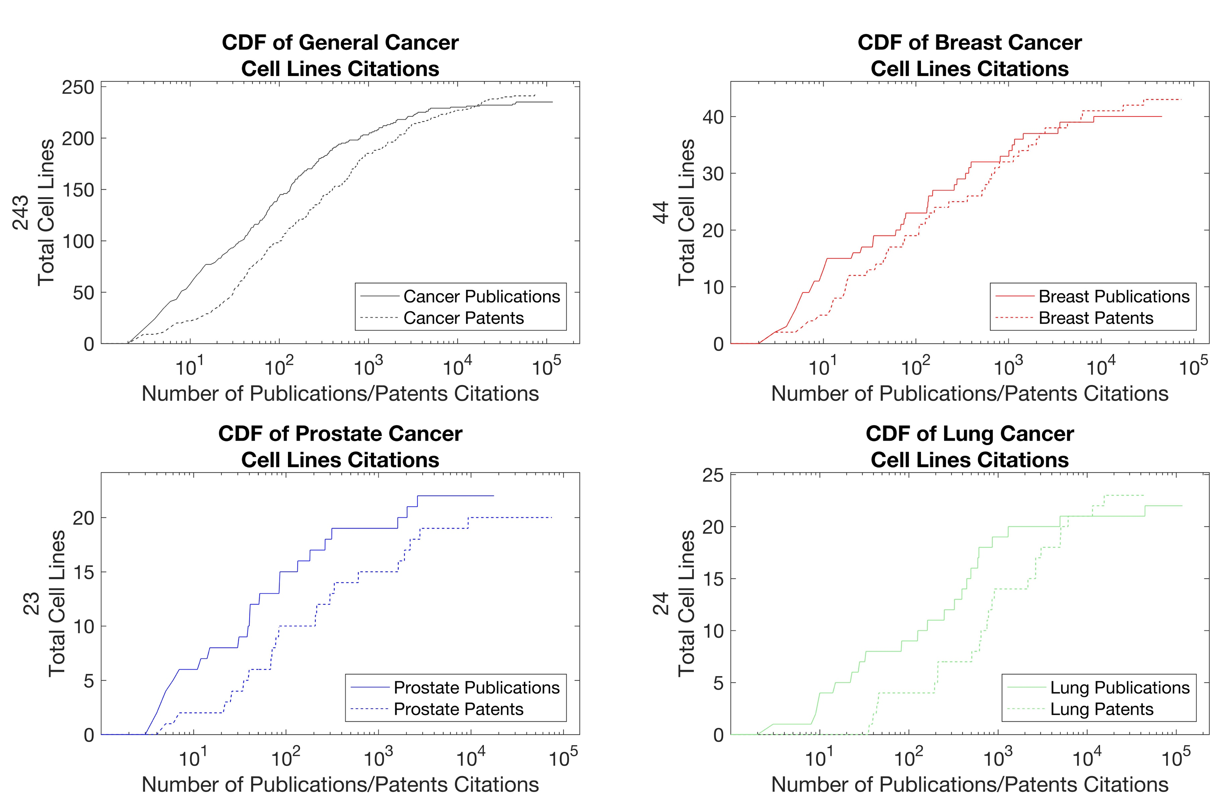
Patents use less cell lines, more frequently than publications.

Slide 21
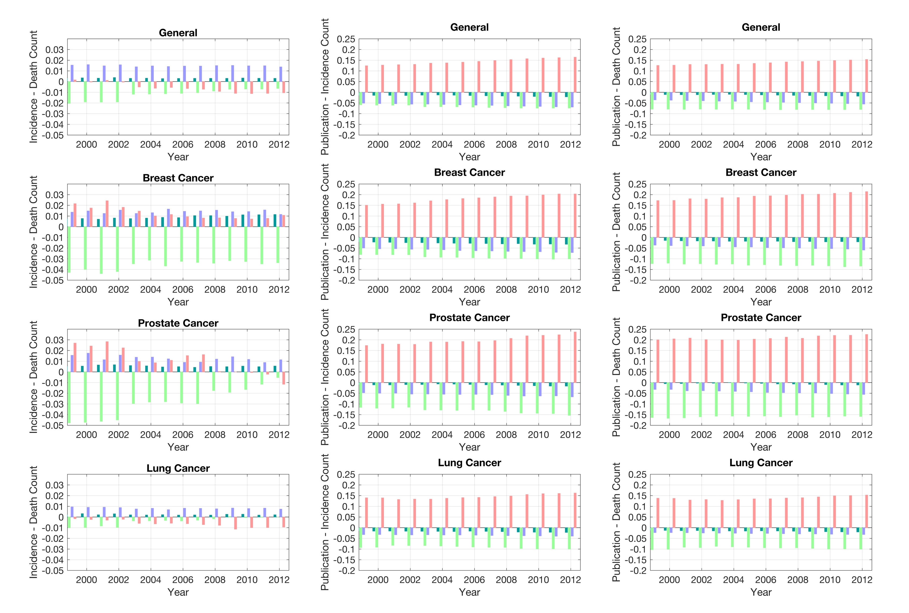
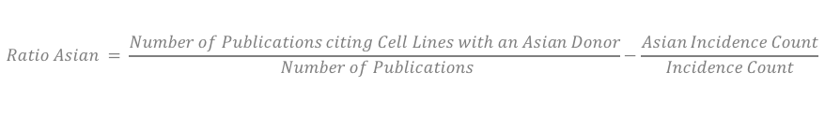
Representative Bias in Published Research Positive numbers, the proportion represented in research is greater than the incidence/death count.
$$Ratio Asian = \frac{Number of Publications citing Cell Lines with an Asian Donor}{ Number of Publications}−\frac{Asian Incidence Count}{Incidence Count}$$

Slide 22
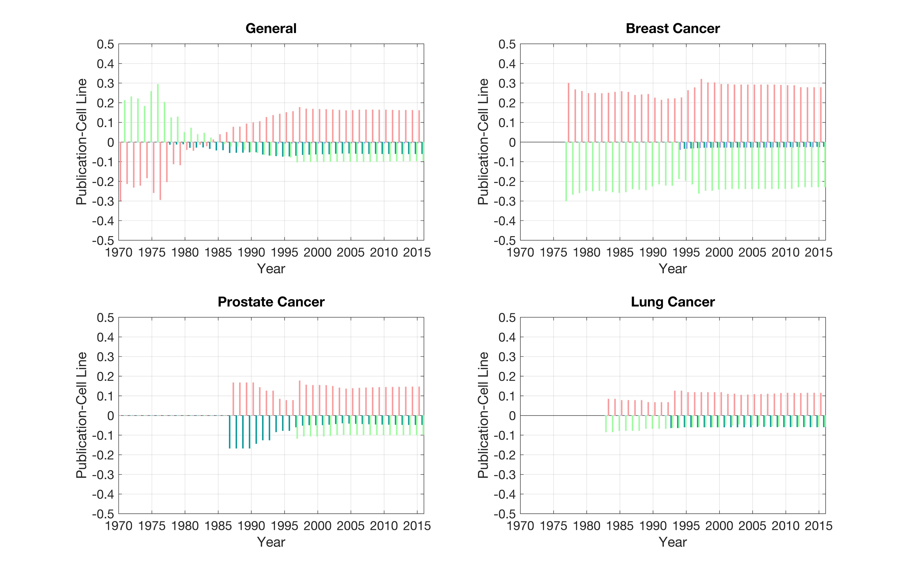
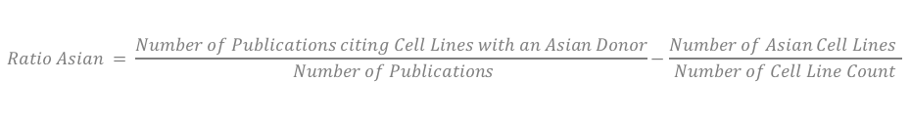
Representative Bias in Use of Cell Lines Positive numbers, the proportion represented in research is greater than proportion in cell lines.
$$Ratio Asian = \frac{Number of Publications citing Cell Lines with an Asian Donor}{ Number of Publications}−\frac{Number of Asian Cell Lines }{Number of Cell Line Count}$$

Slide 23
Next tasks
Investigate lung cancer
Investigate graphical test to quantify bias

Slide 24
Supplemental

Slide 25
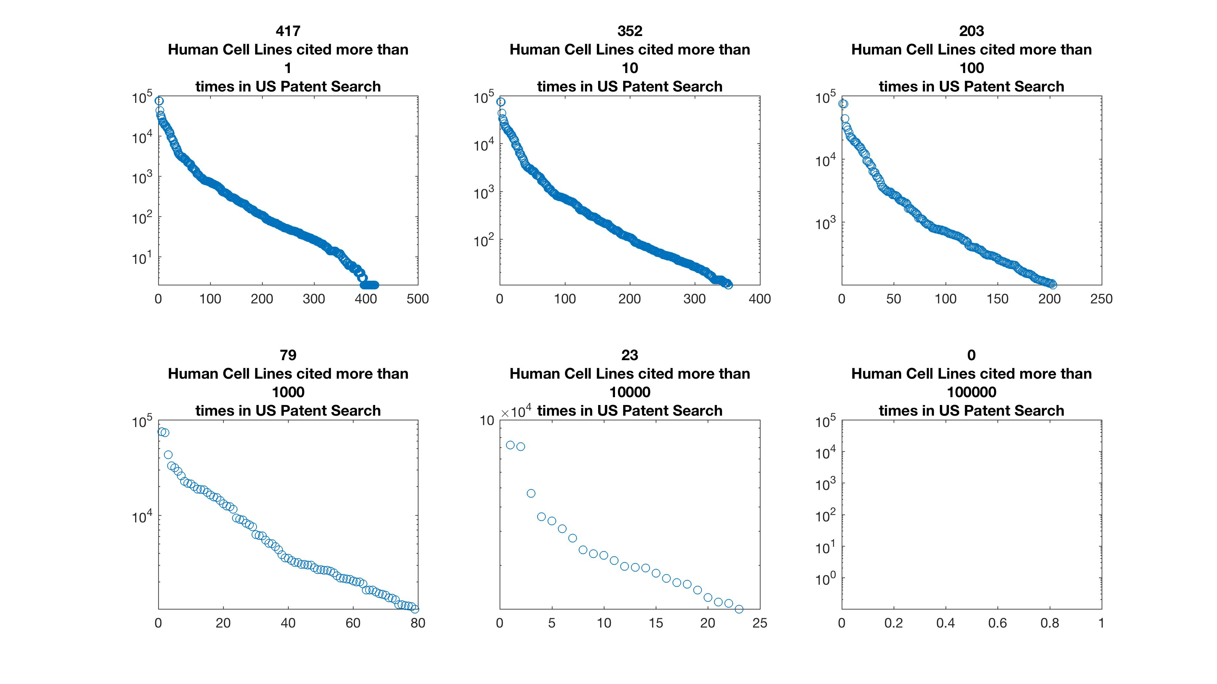
Uniqueness of Cell Lines in Patents

Slide 26
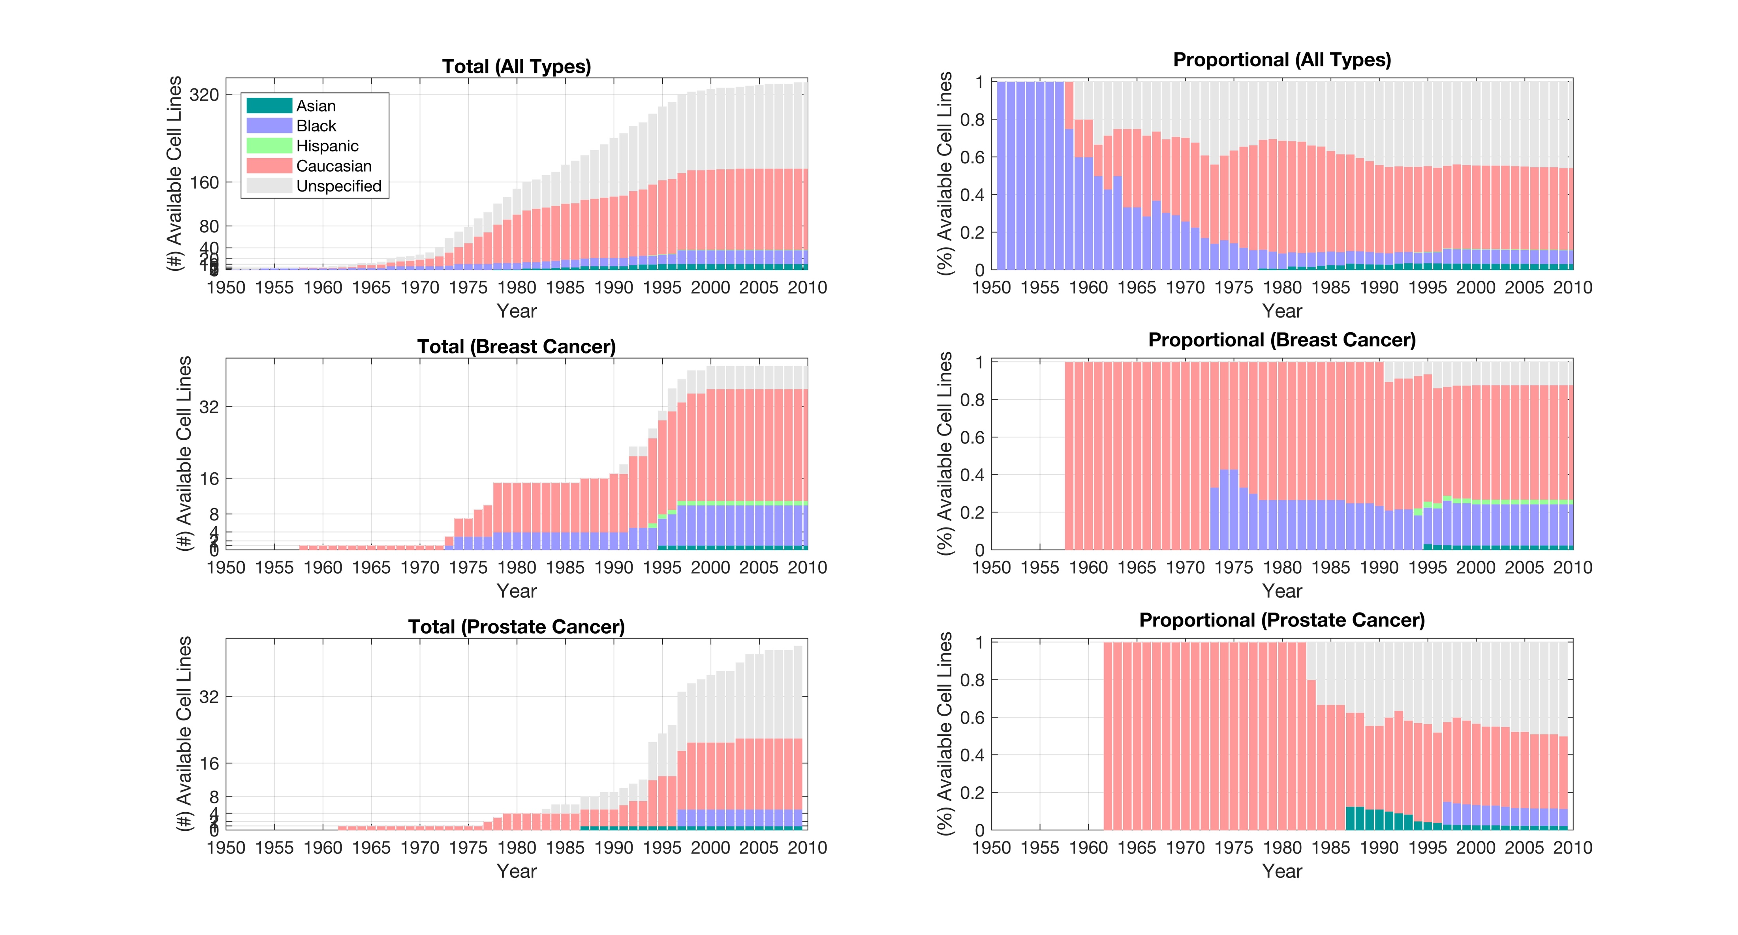
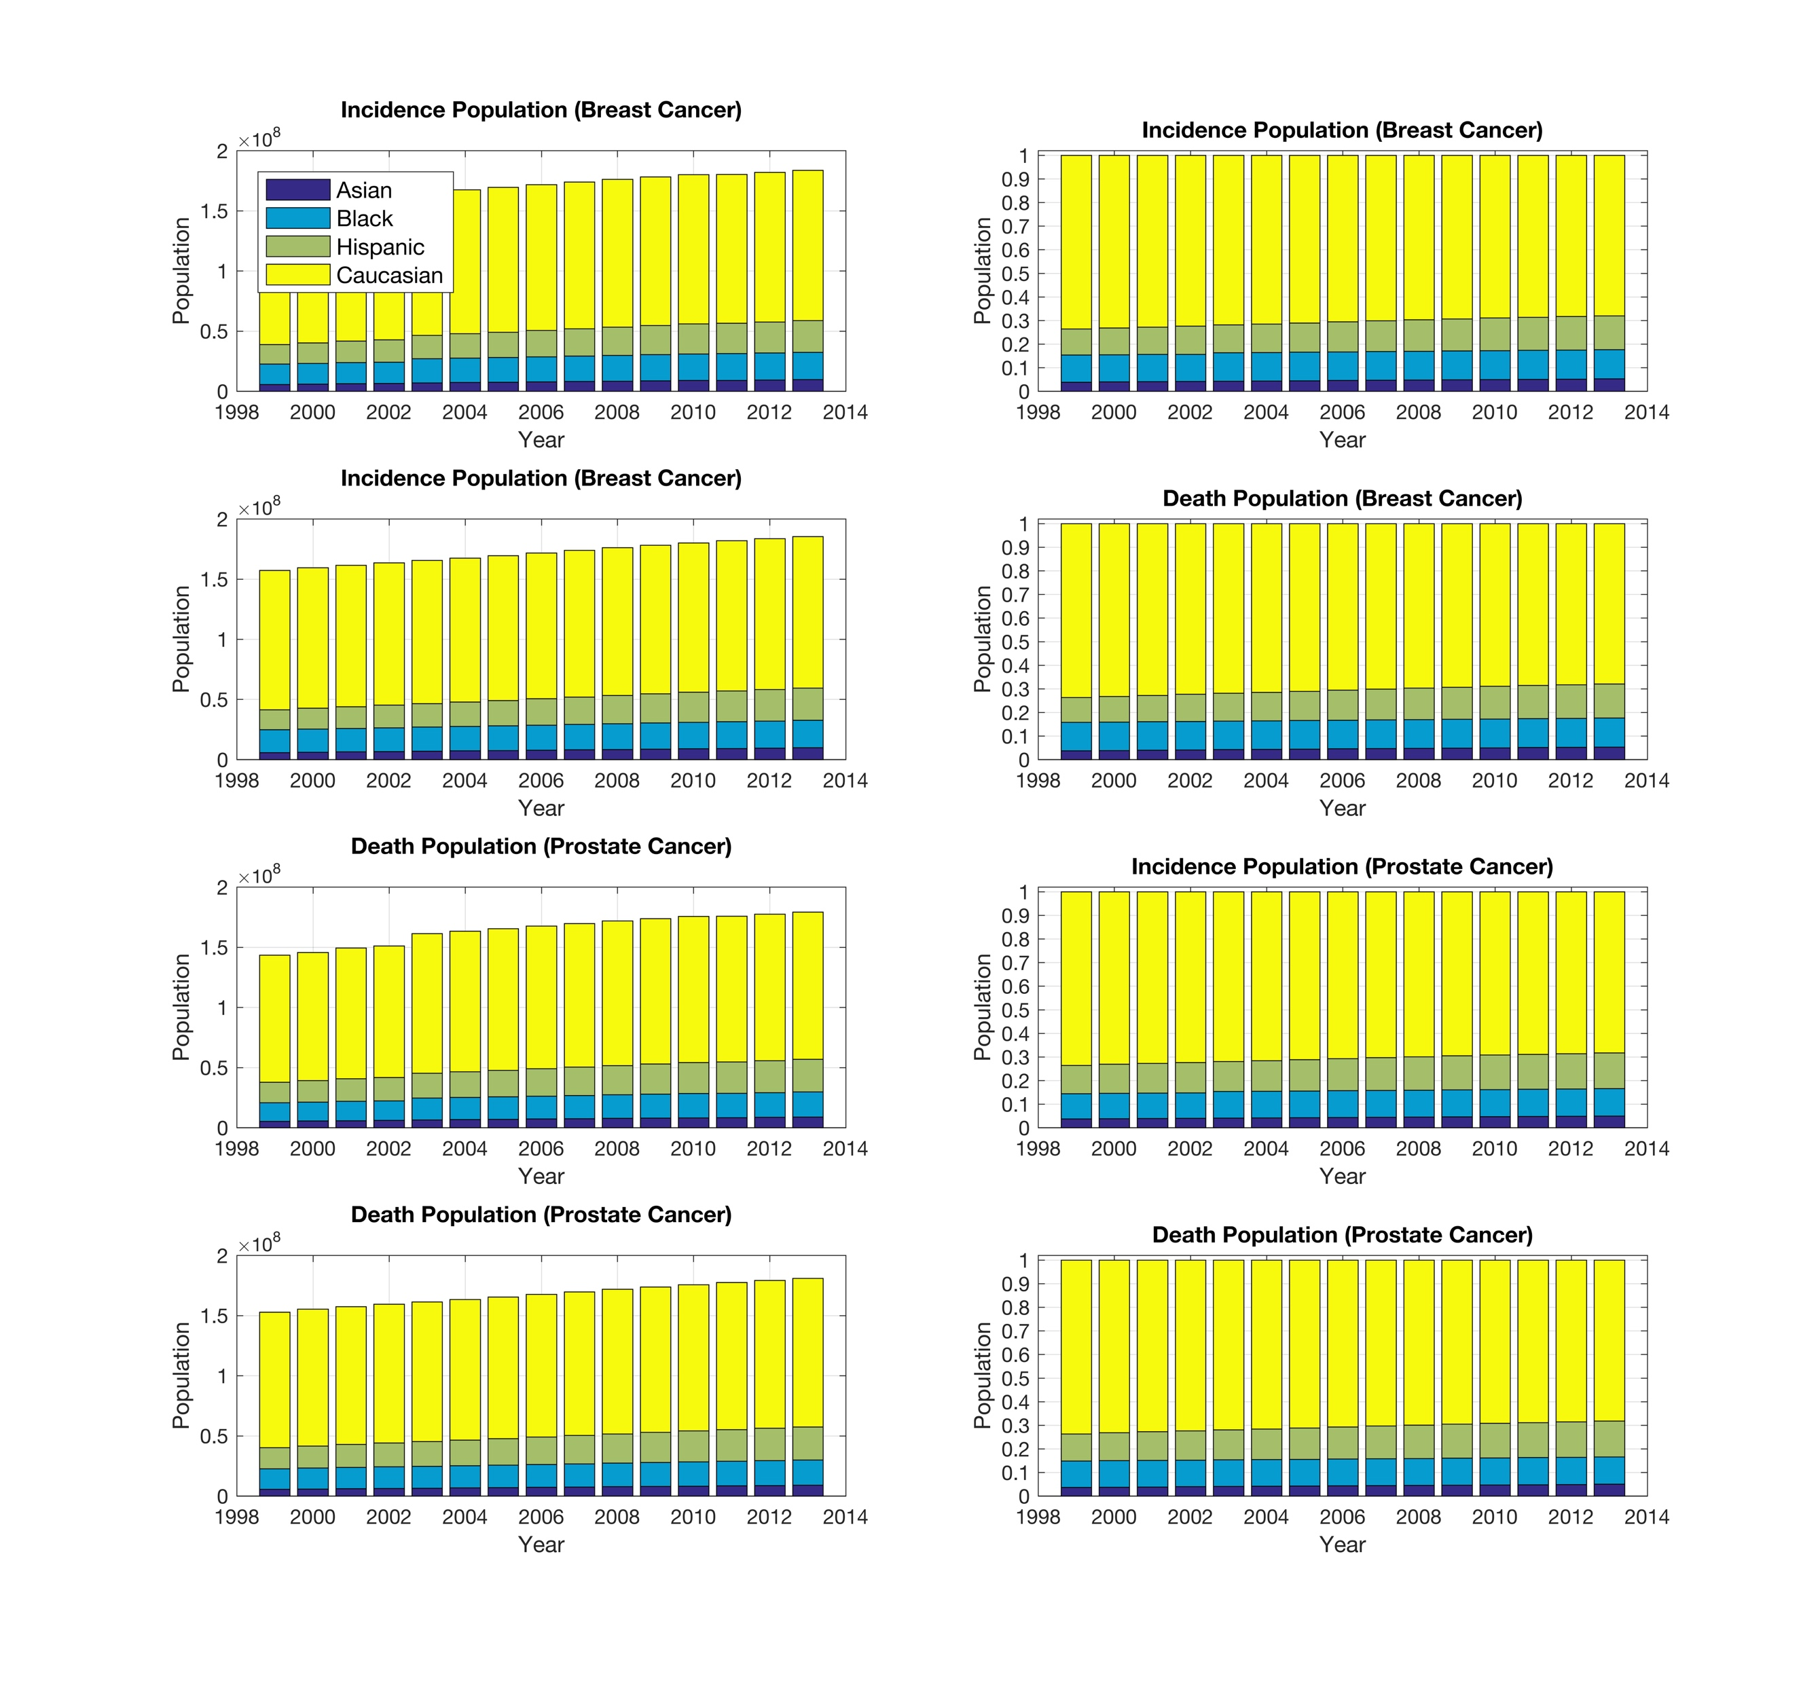
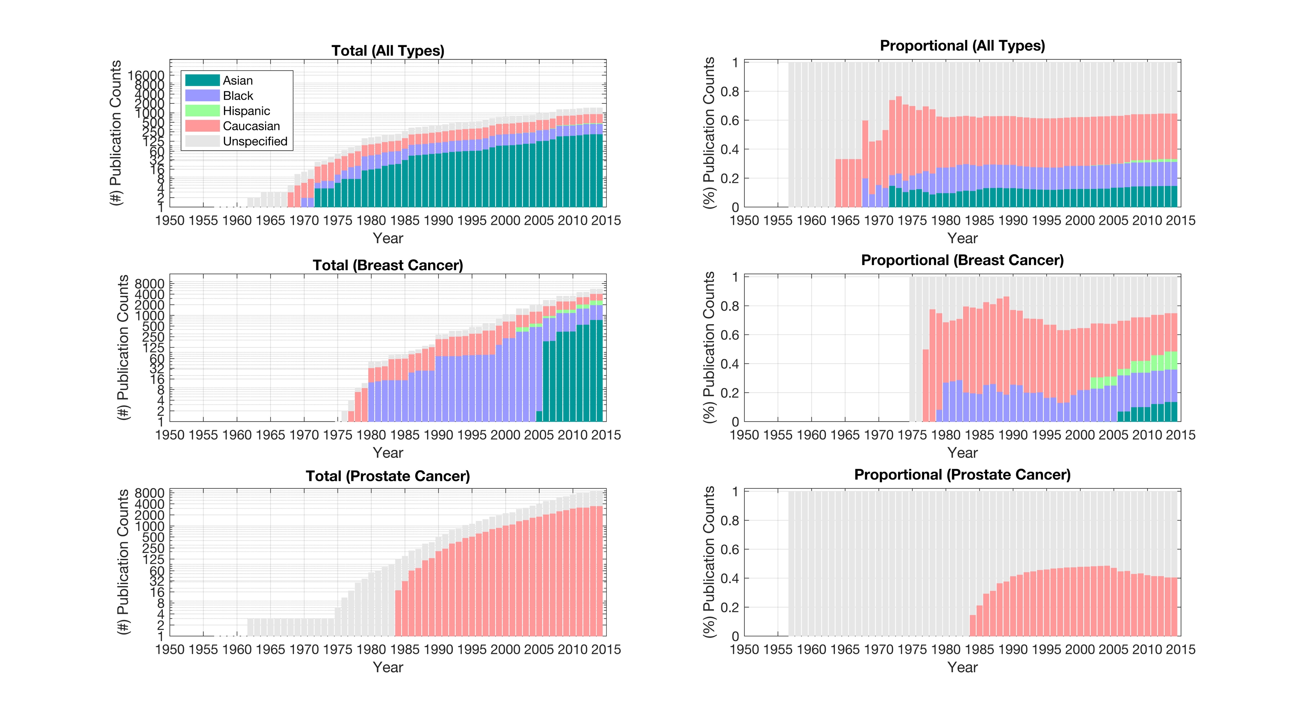
The demographics of breast cancer patients, donors to breast cancer cell lines, and citations in publications.
2. Who are the donors for breast cell lines?
1. Who is effected by breast cancer?
3. How are the cell lines used in publications?

Slide 27
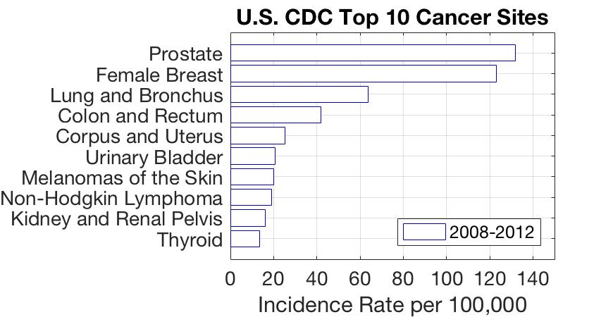
US Center for Disease Control (CDC) Statistics for Top Cancer Sites

Slide 28
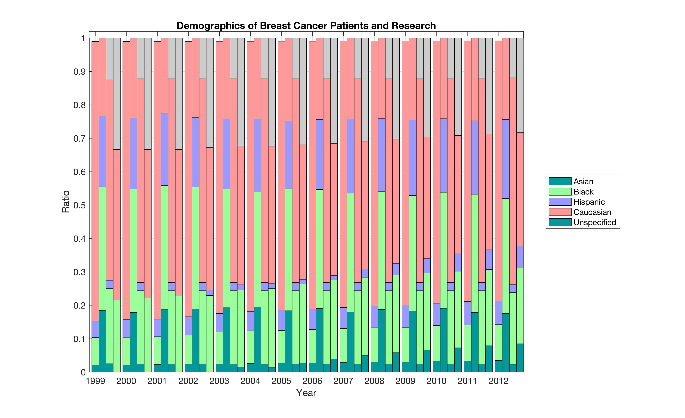
The demographics of breast cancer patients, donors to breast cancer cell lines, and citations in publications. Each grouping column from left to right (Incidence Rate, Morbidity Rate, Cell Line Available, Publication Record)

Slide 29
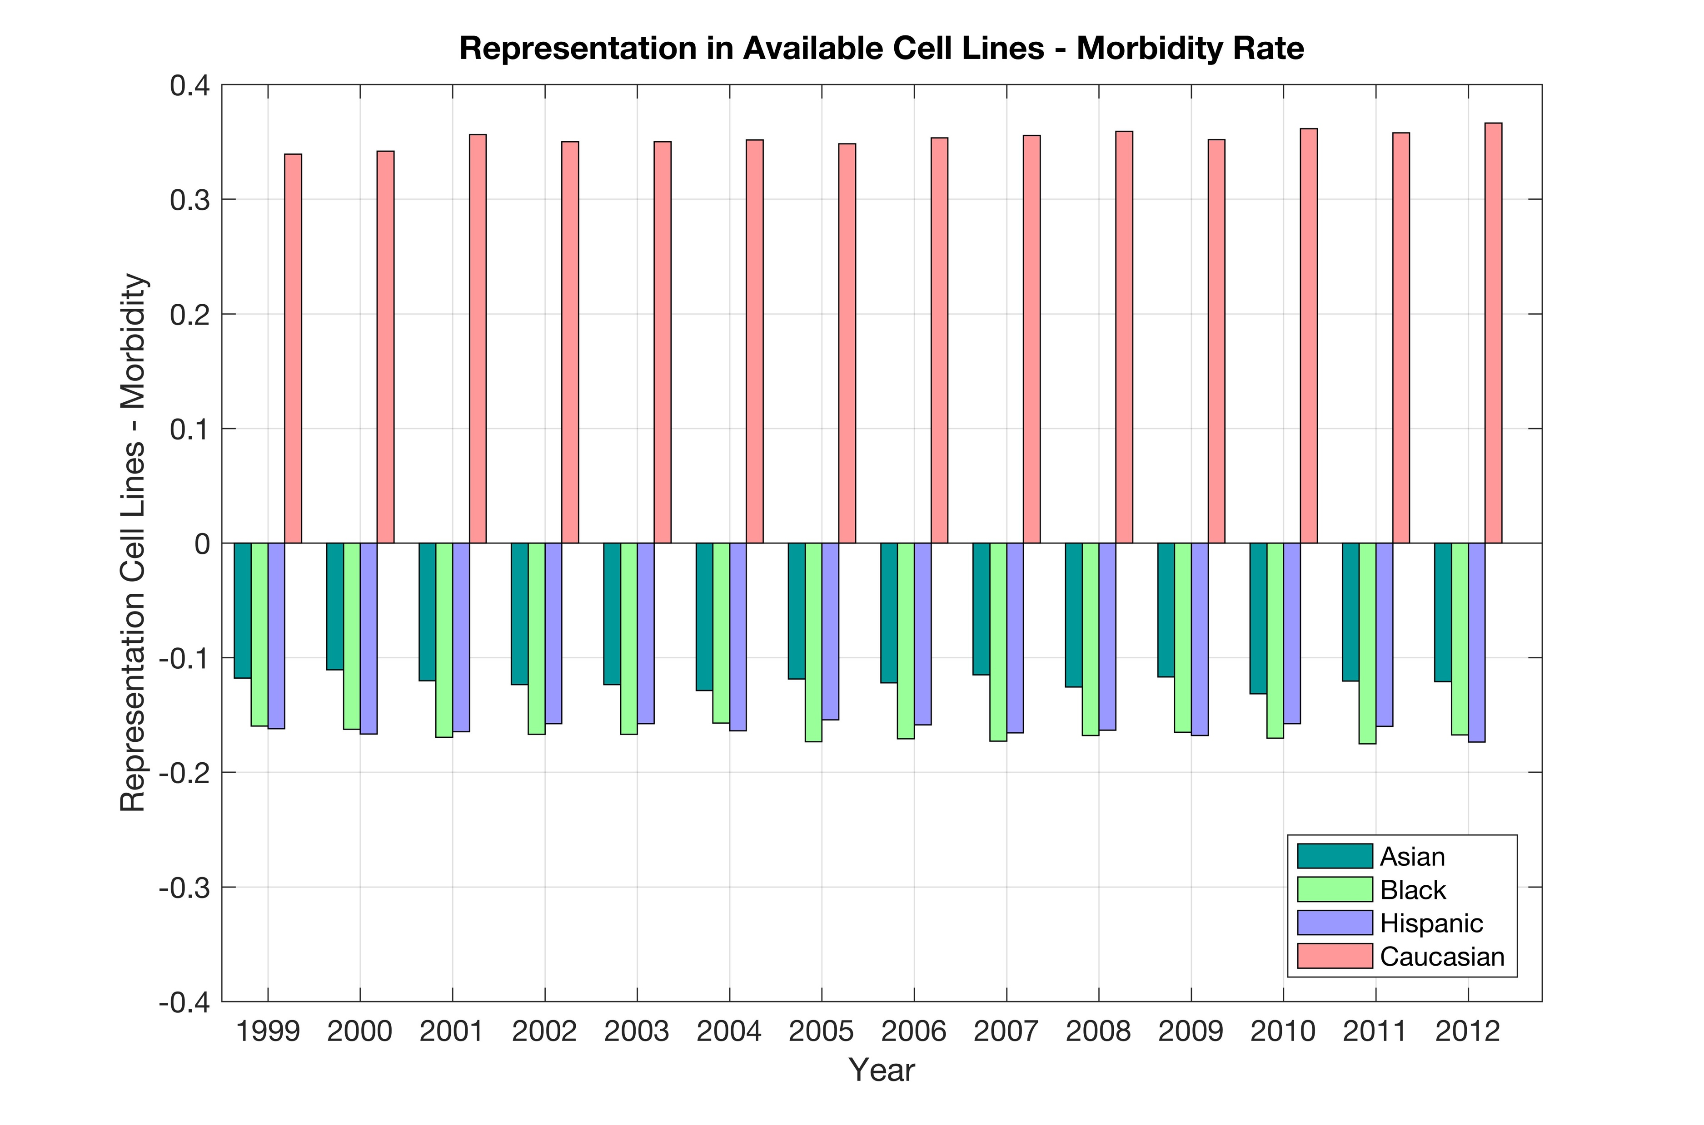

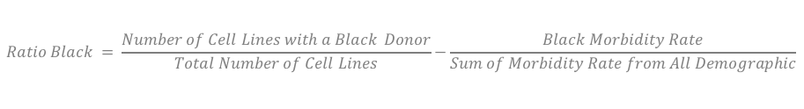


The difference between each demographics' representation in cell lines and normalized morbidity rate.
$$Ratio Asian = \frac{Number of Cell Lines with an Asian Donor}{Total Number of Cell Lines}−\frac{Asian Morbidity Rate}{Sum of Morbidity Rate from All Demographic}$$
$$Ratio Black = \frac{Number of Cell Lines with a Black Donor}{Total Number of Cell Lines}−\frac{Black Morbidity Rate}{Sum of Morbidity Rate from All Demographic}$$
$$Ratio Hispanic= \frac{Number of Cell Lines with an Hispanic Donor}{Total Number of Cell Lines}−\frac{Hispanic Morbidity Rate}{Sum of Morbidity Rate from All Demographic}$$
$$Ratio Caucasian = \frac{Number of Cell Lines with a Caucasian Donor}{Total Number of Cell Lines}−\frac{Caucasian Morbidity Rate}{Sum of Morbidity Rate from AllDemographic}$$

Slide 30
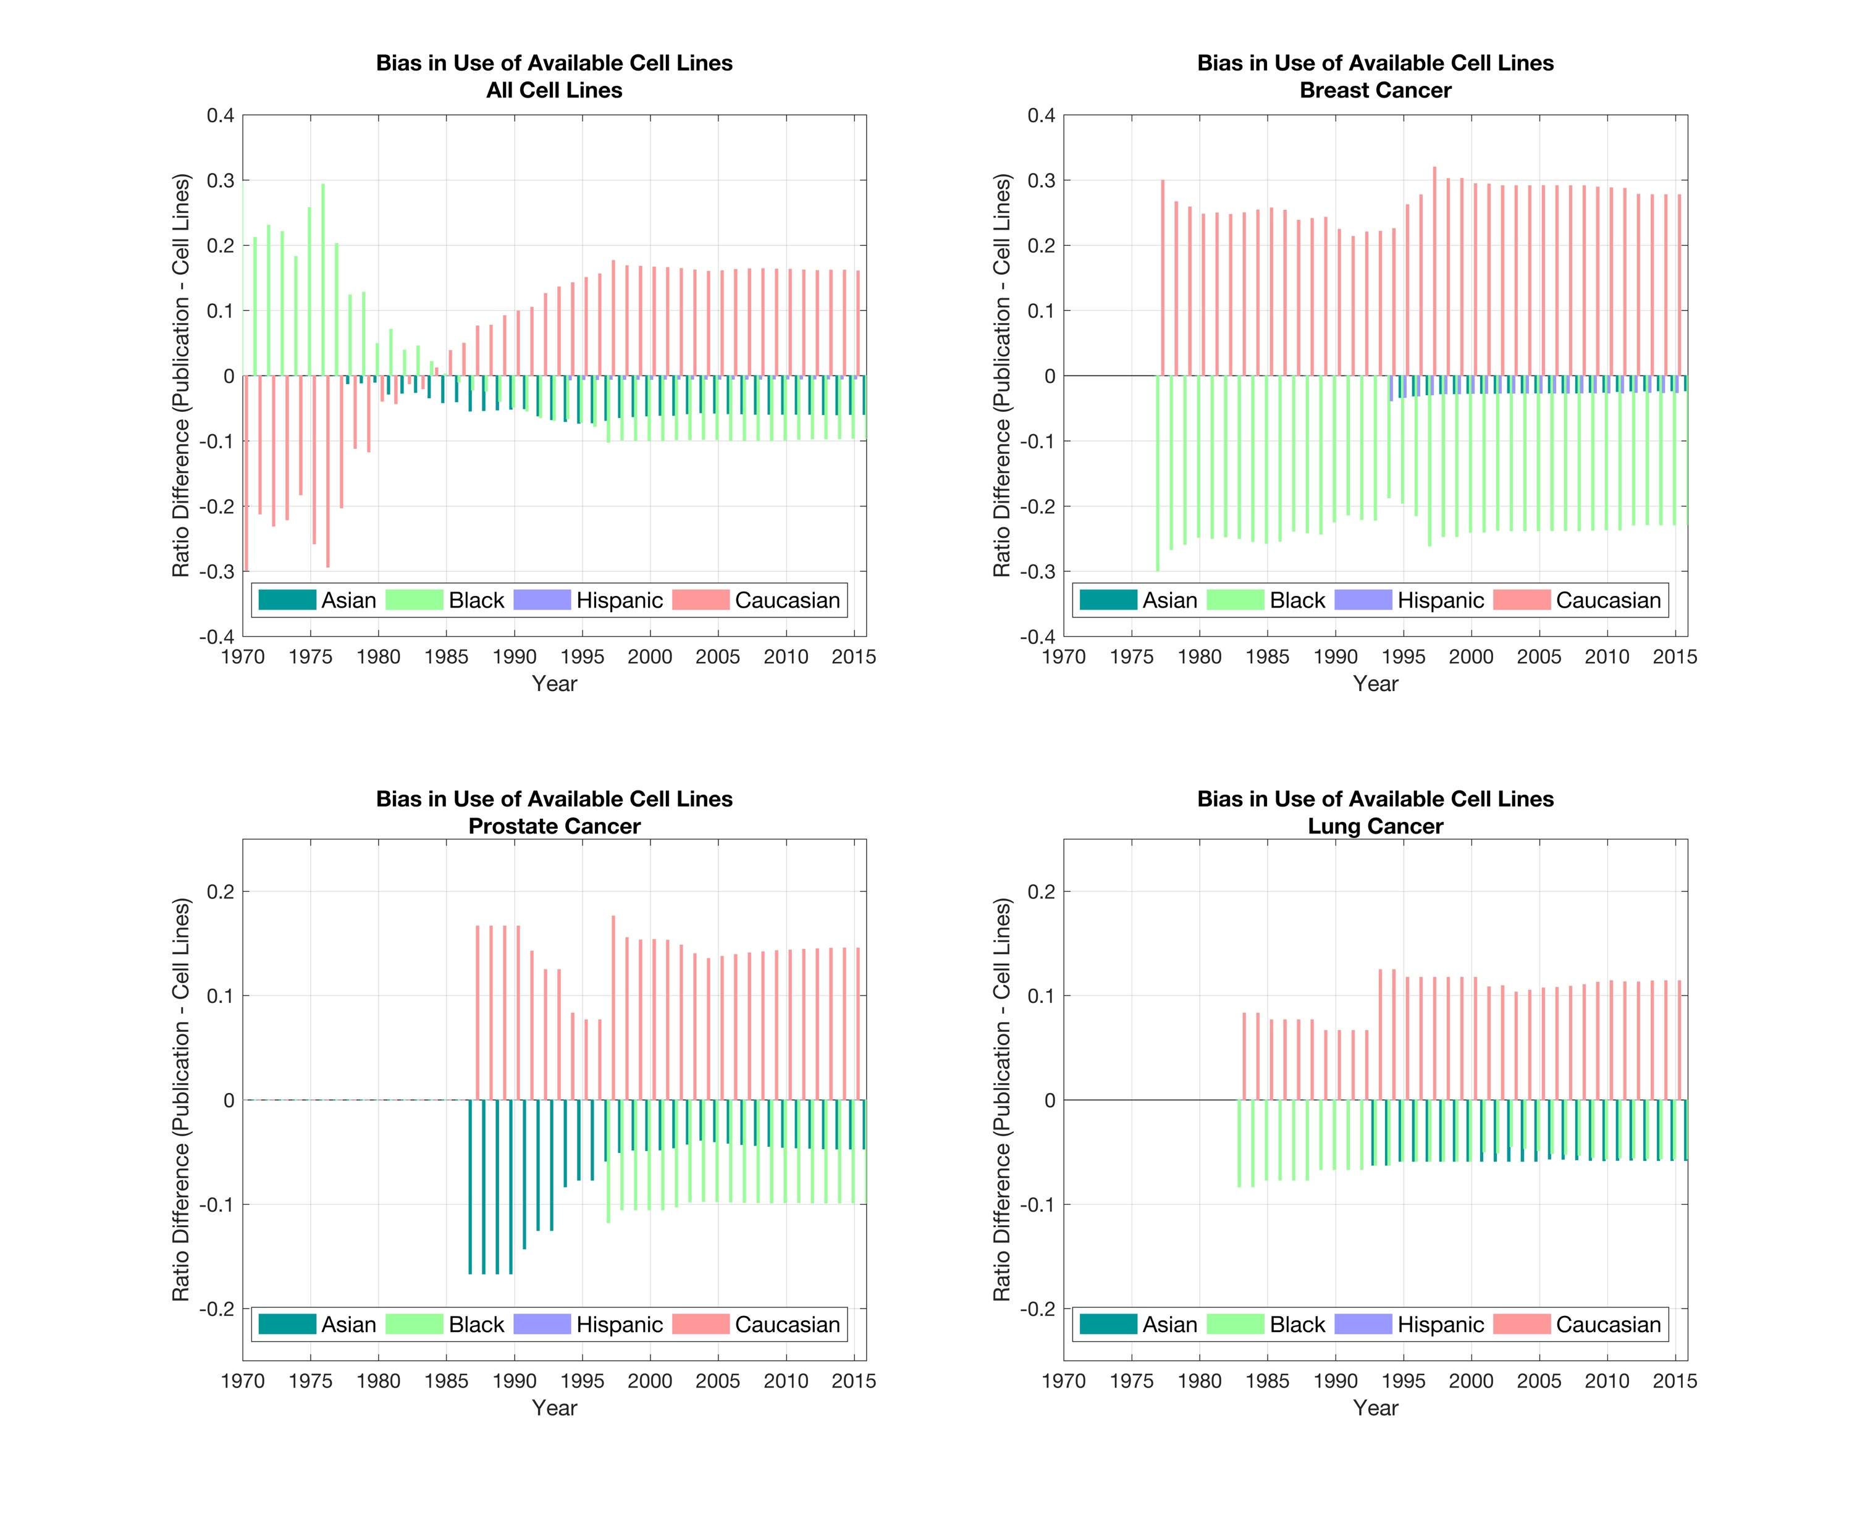


Bias in the use of available cell lines in breast and prostate cancer research.
$$\frac{Cell Lines from a Race}{Number of Cell Lines}<\frac{Publication Citing Race }{Number of Publications }$$
$$\frac{Cell Lines from a Race}{Number of Cell Lines}>\frac{Publication Citing Race }{Number of Publications }$$

Slide 31
CDC statistics on demographics of a cancer populations

Slide 32
Timeline of demographic inclusiveness of the cell lines available to researchers.

Slide 33
Demographic representation in published research using human cell lines.

Slide 34
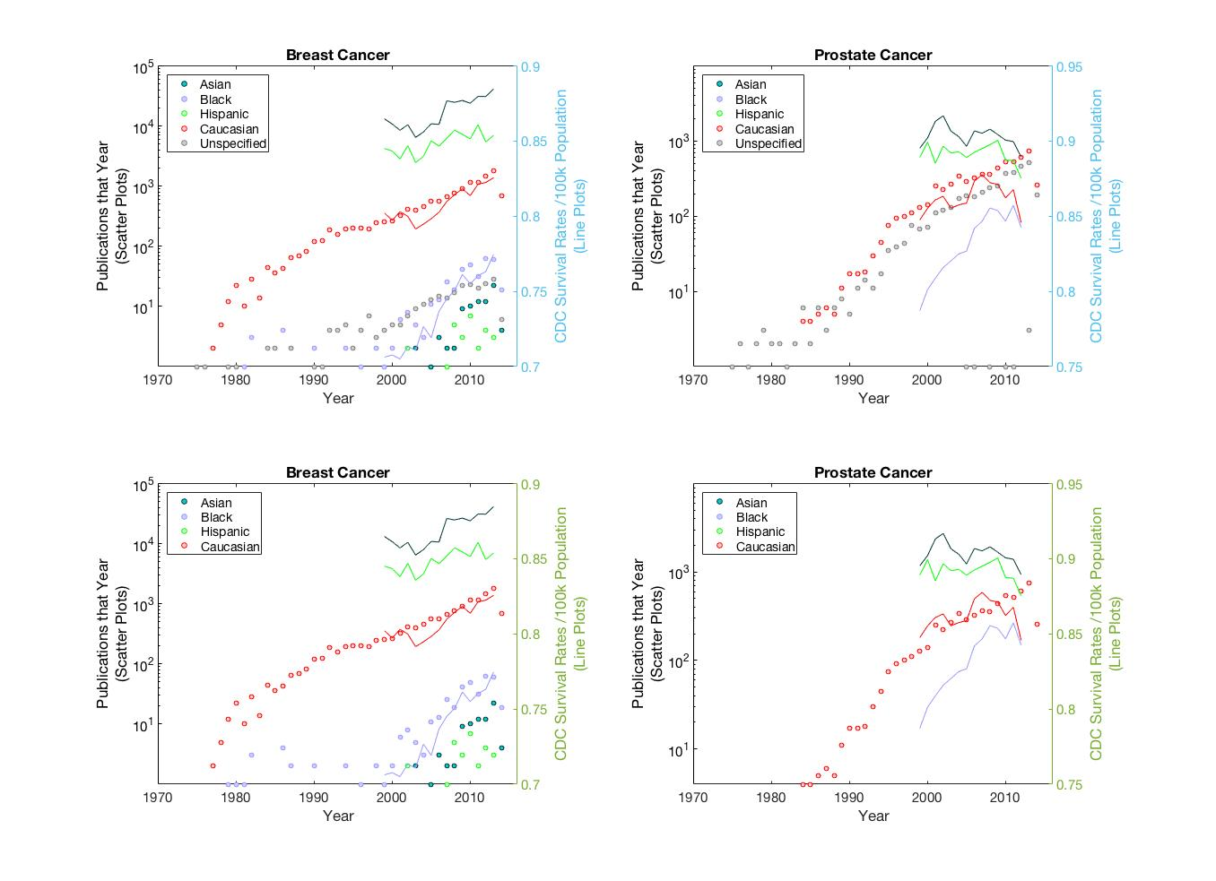
Number of publications using cell lines of the specified demographics, plotted with CDC survivability rates

Slide 35
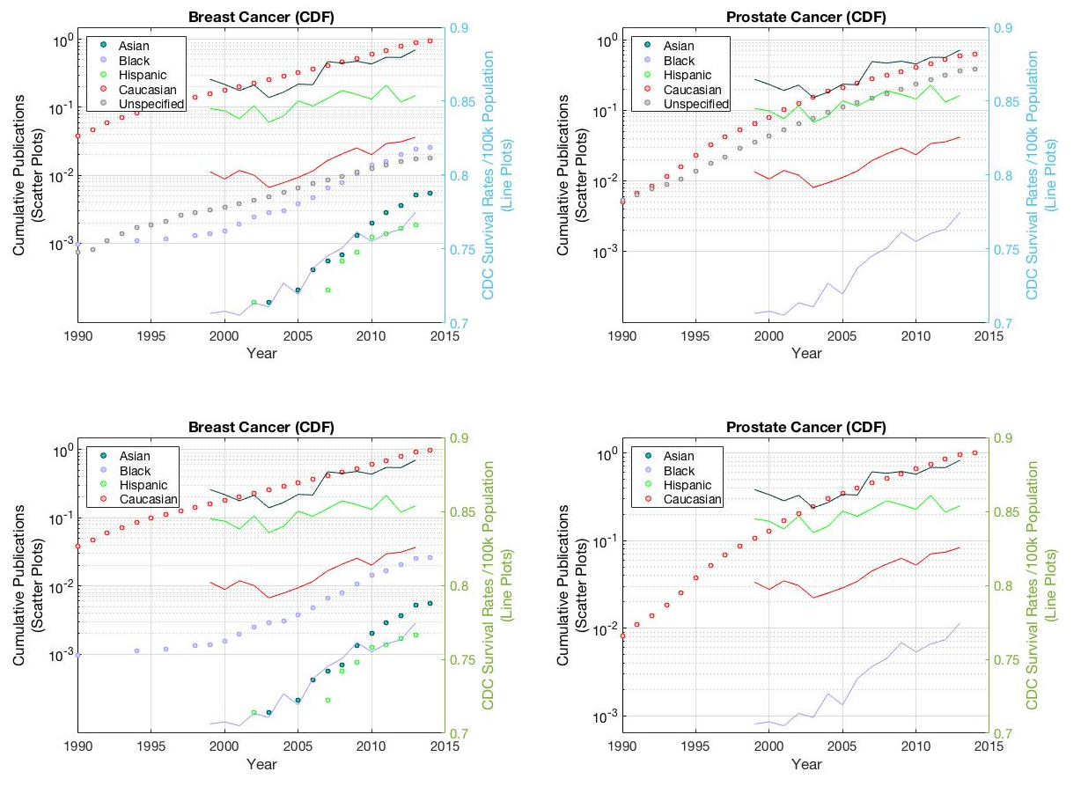
Cumulative Distribution Function (CDF) of publications with CDC Survivability Rates

Slide 36
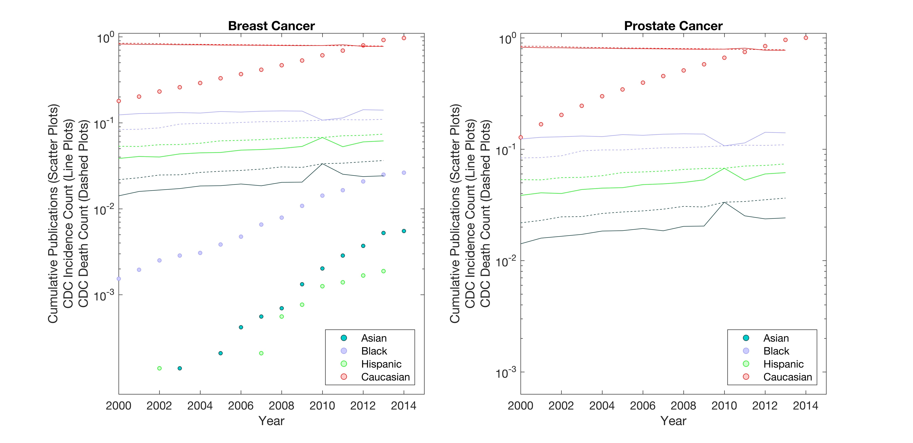
Cumulative Distribution Function (CDF) of Publications with CDC Incidence and Death Counts

Slide 37
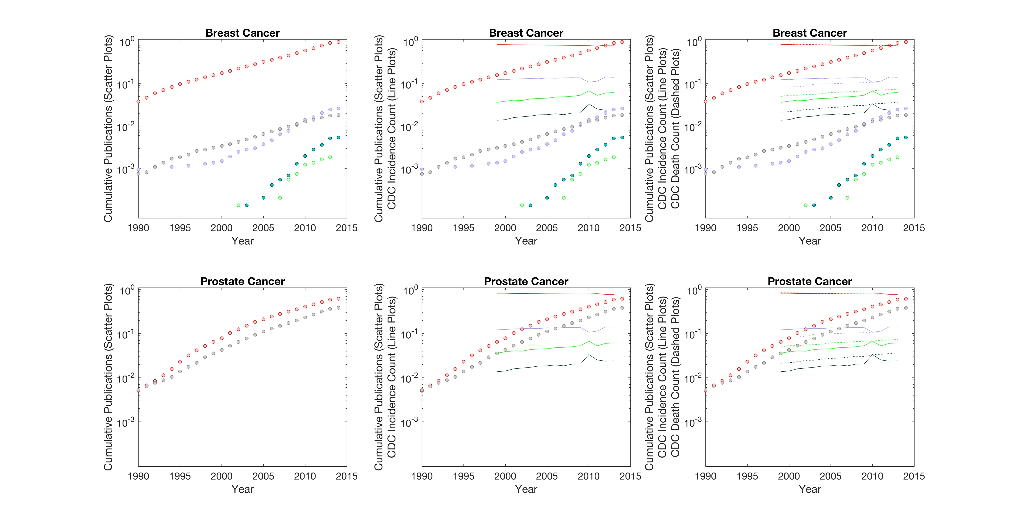
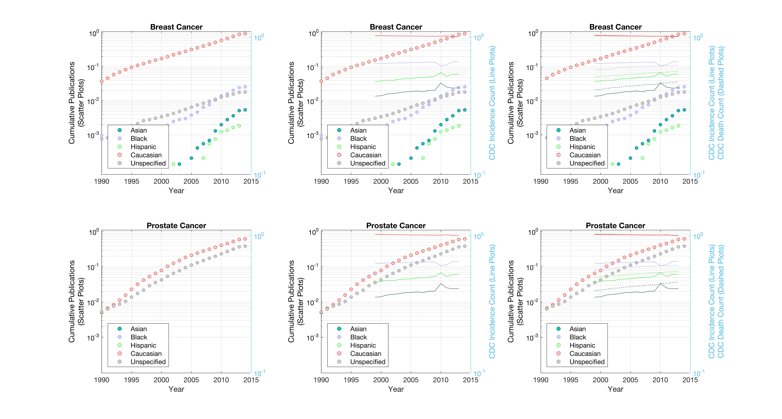
Cumulative Distribution Function (CDF) of Publications with CDC Incidence and Death Counts

Slide 38






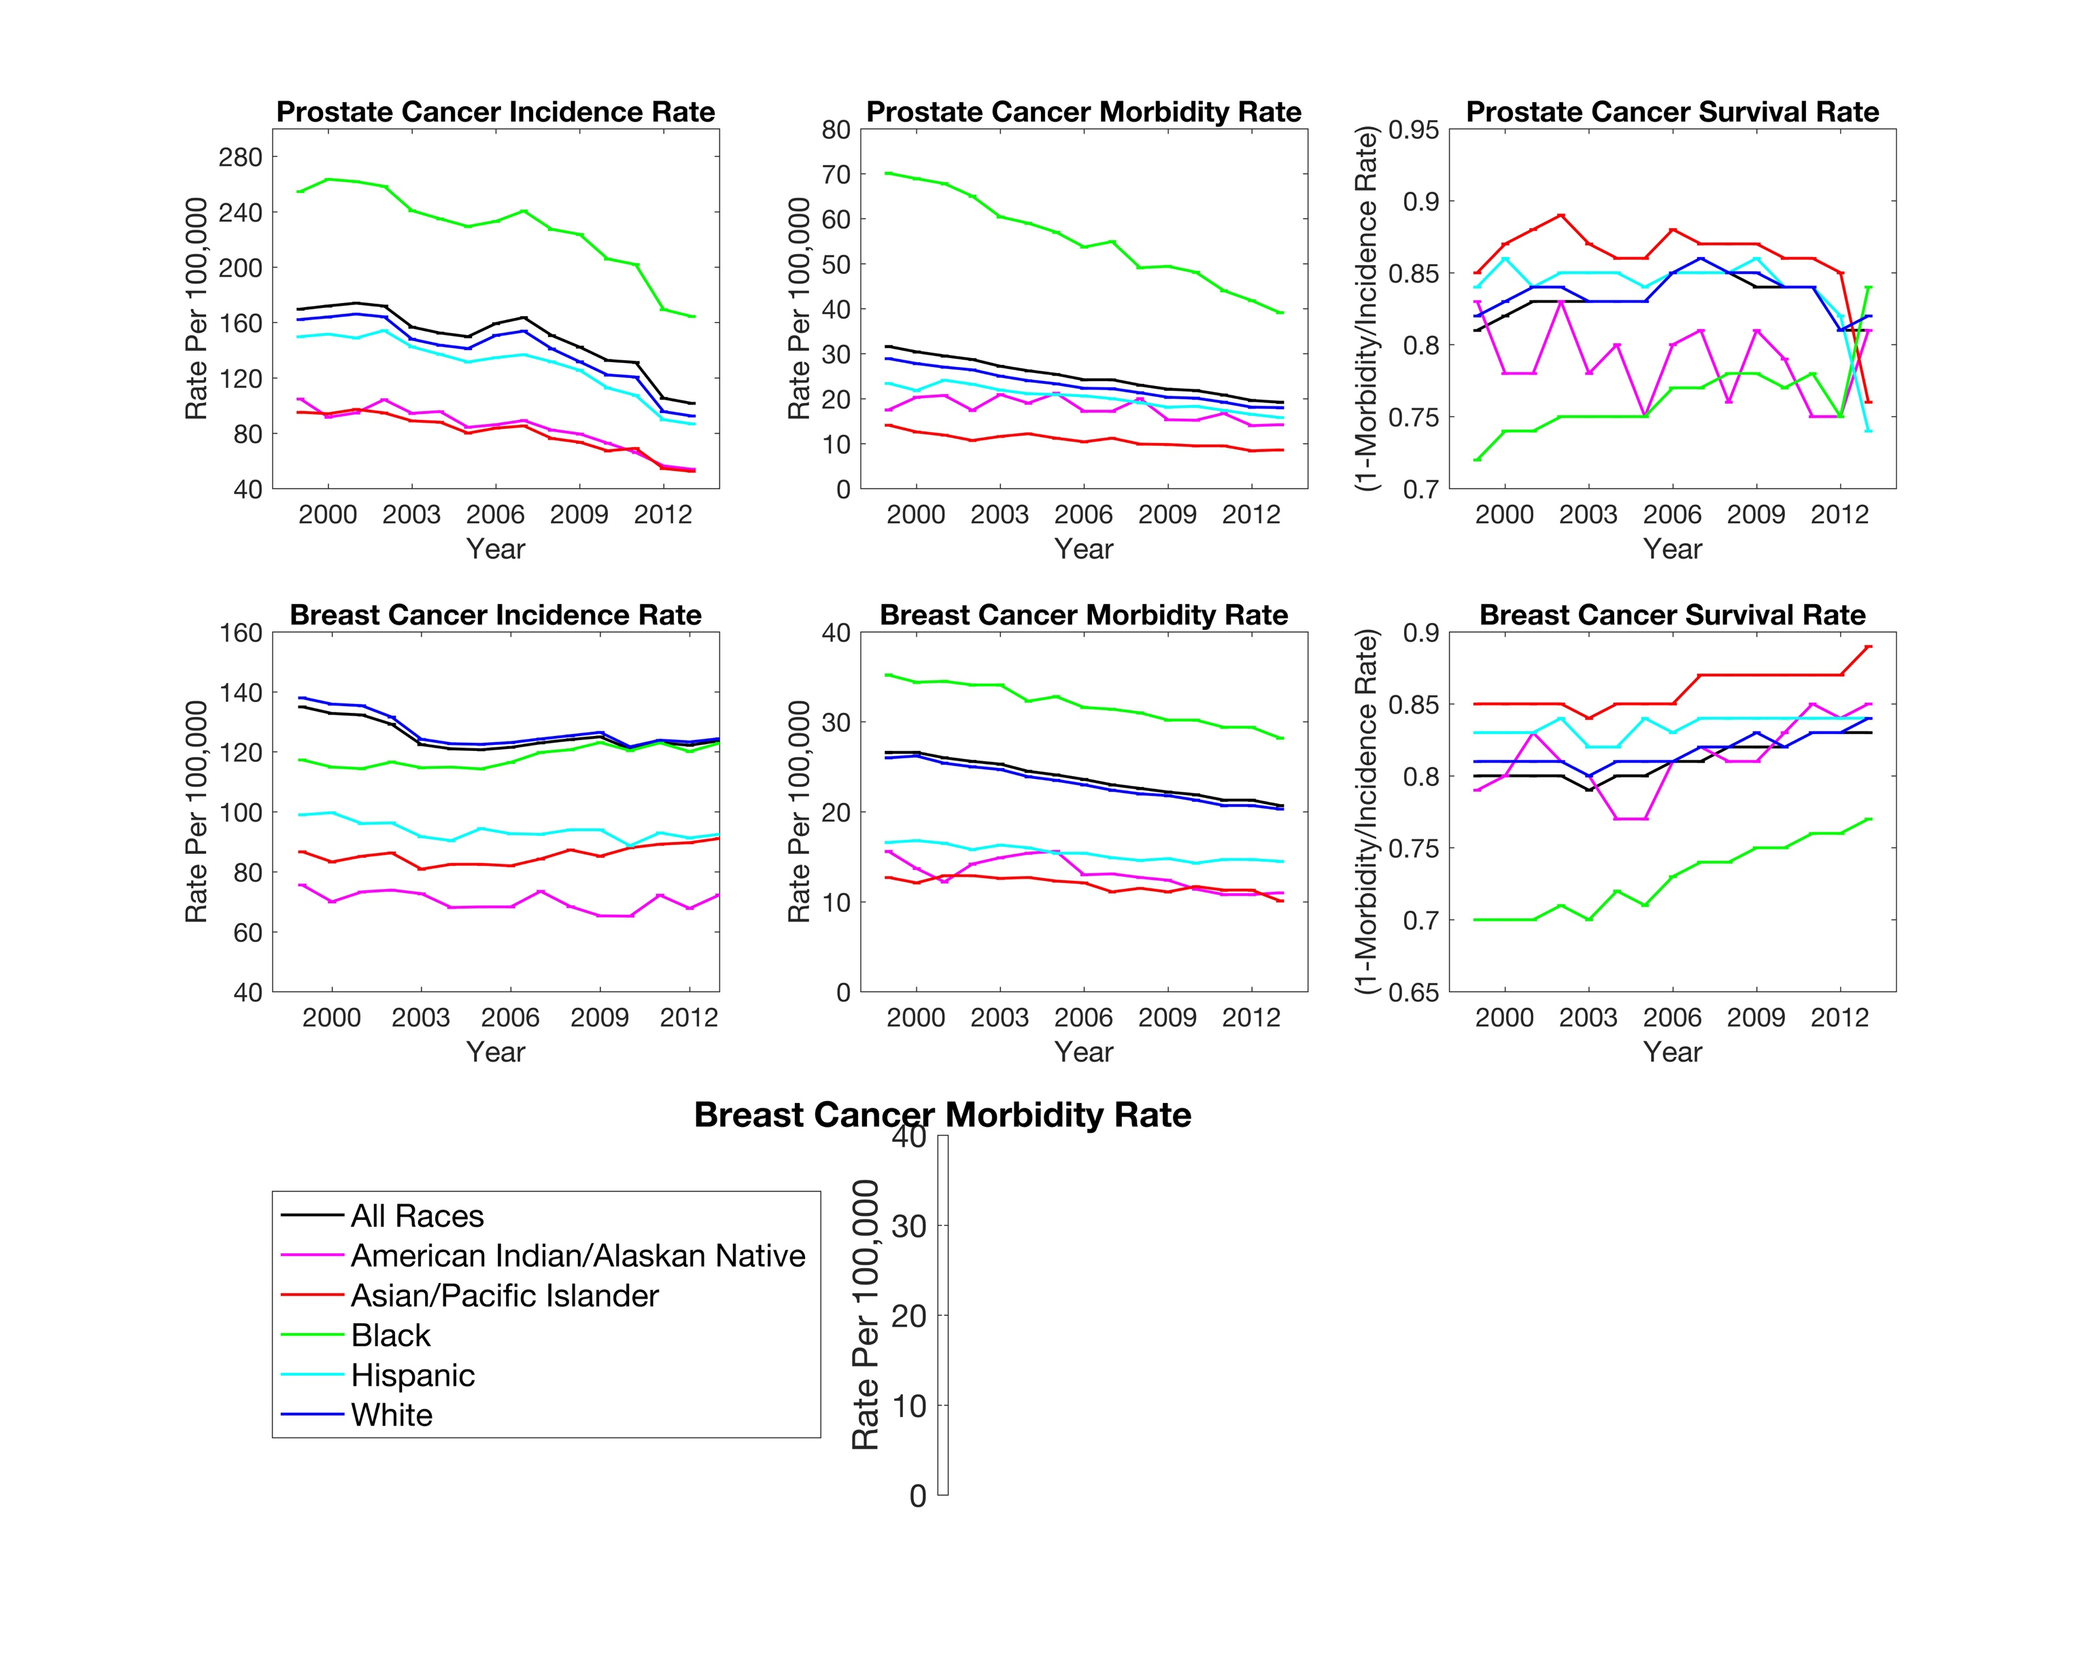
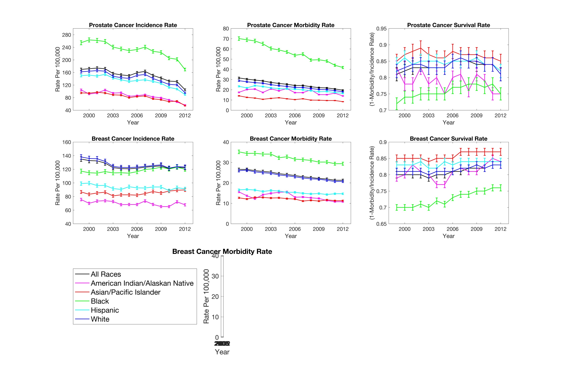
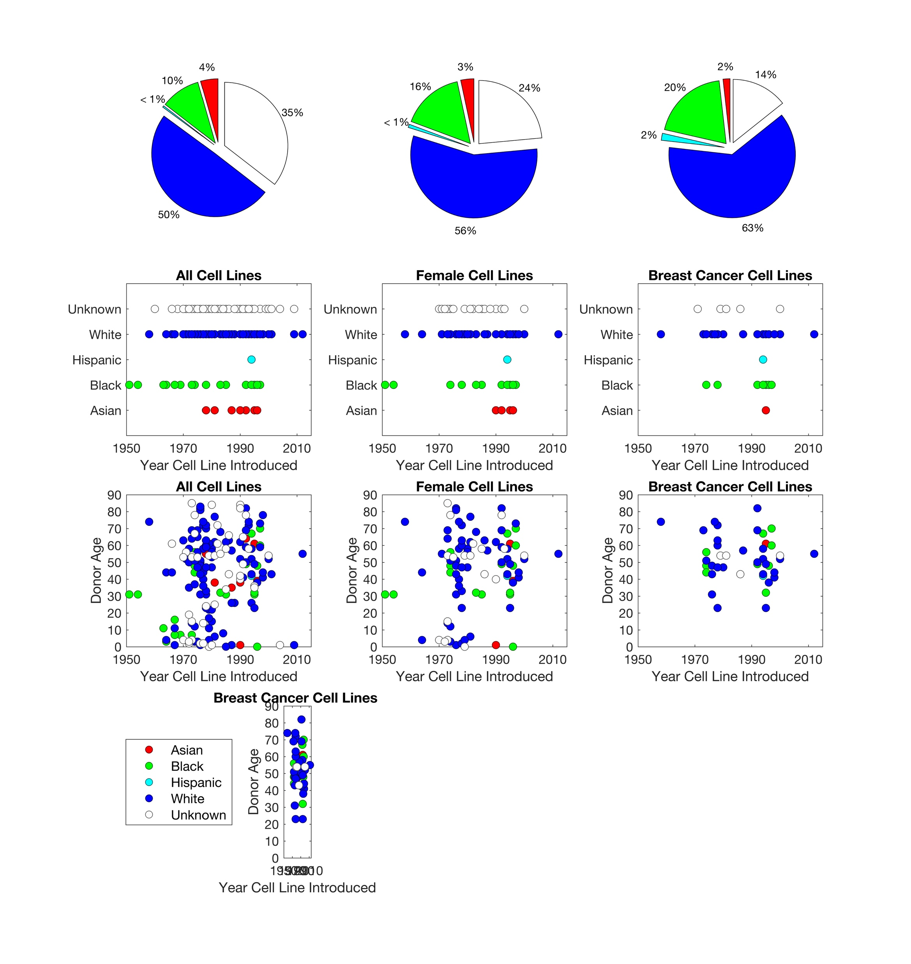
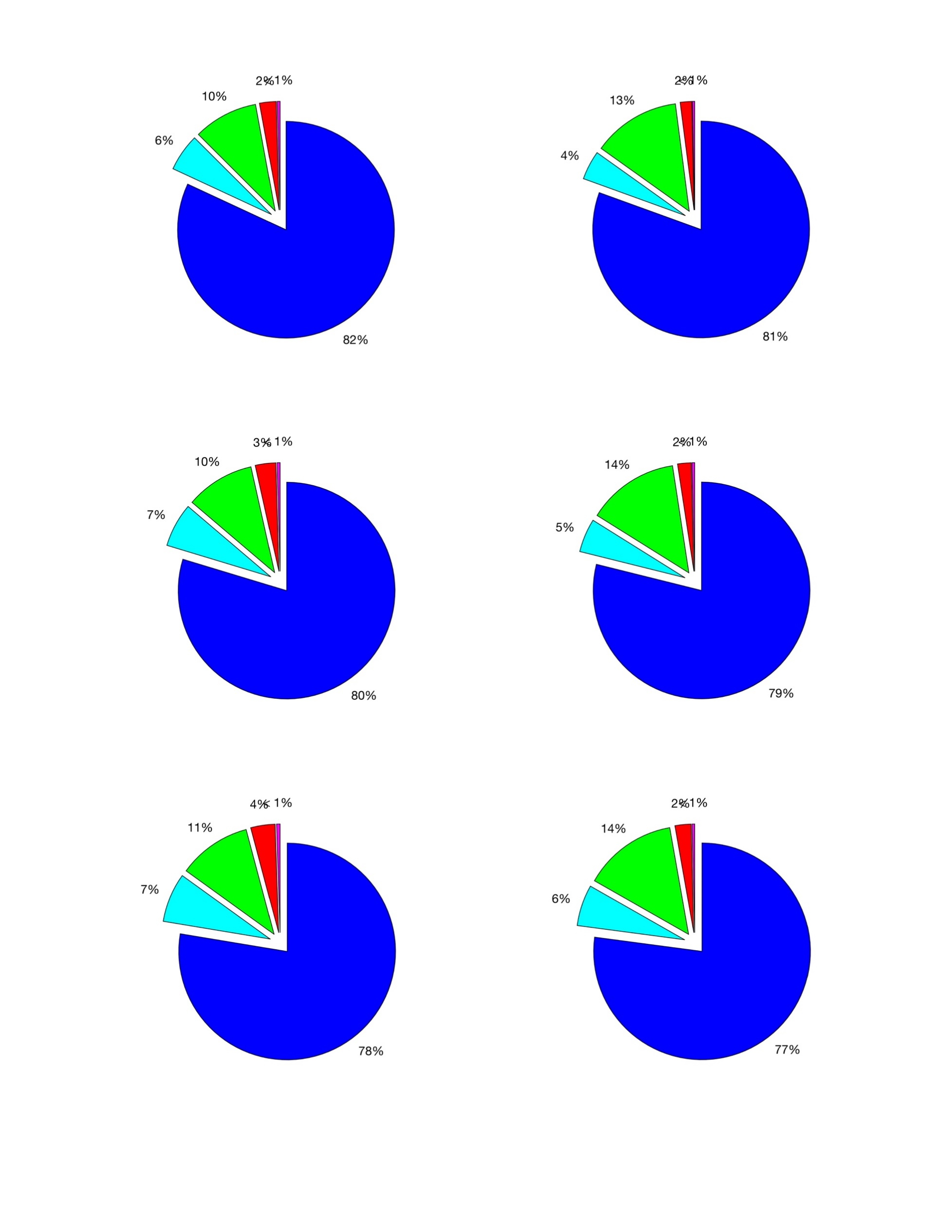
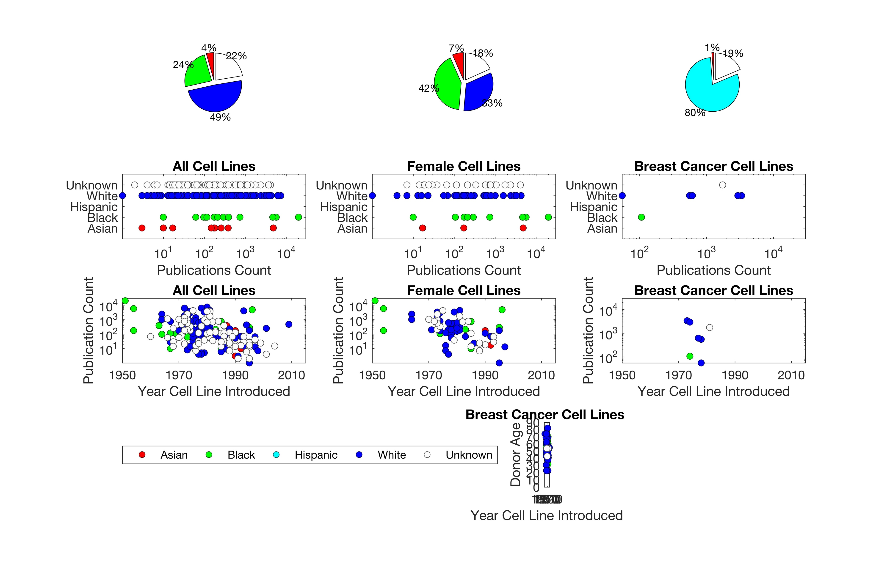
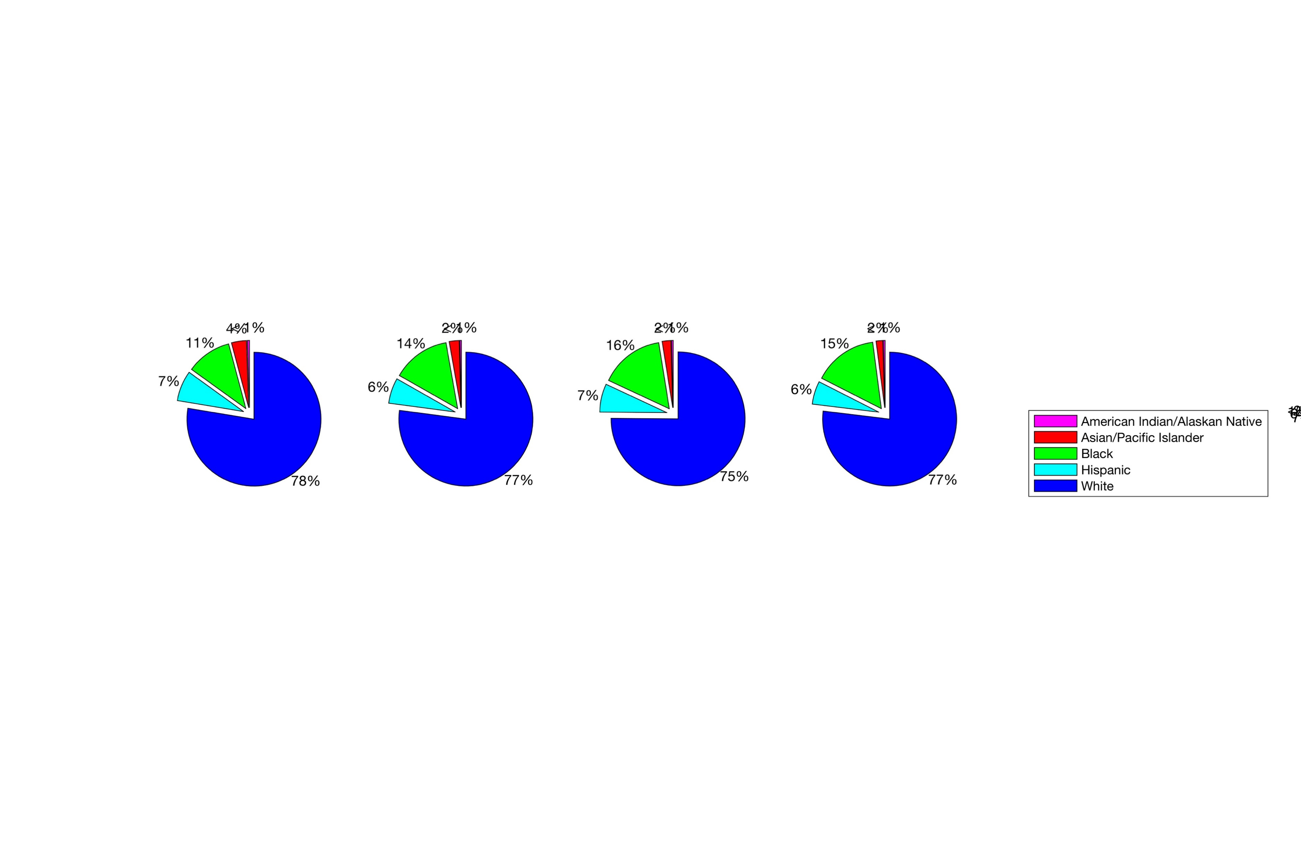
Demographic Inclusiveness in Human Cell Studies
Iva Bojic^{1,2}
Aaron Gerow³
Jessica Snyder^{1,2}
Carlo Ratti^{1,2} (ratti@mit.edu)
SENSEable City Lab, Department of Urban Studies and Planning, Massachusetts Institute of Technology
SENSEable City Lab, Future Urban Mobility Interdisciplinary Research Group, Singapore-MIT Alliance for Research and Technology
Computation Institute, University of Chicago
RATIONALE: WHAT IS THE DEMOGRAPHIC REPRESENTATION DURING MEDICAL RESEARCH? COULD REPRESENTATION EFFECT THE EFFICACY OF TREATMENT?
STEP 1. DISCOVERY AND DEVELOPMENT
STEP 2. PRECLINICAL RESEARCH
STEP 3. CLINICAL RESEARCH
STEP 4.
FDA REVIEW
DRUG DEVELOPMENT PROCESS
HUMAN CELL MODEL
ANIMAL MODEL
STEP 5.
POST-MARKETING
SAFETY MONITORING
Step 2 to become increasingly significant with advances in tissue engineering
STEP 2 USES HUMAN CELLS.
SHOULD DEMOGRAPHICS BE CONSIDERED?
STEP 3 USES HUMAN SUBJECTS, FDA REQUIRES INCLUSIVE DEMOGRAPHIC REPRESENTATION
Q1. WHERE IS A CURRENT CHALLENGE IN MEDICINE?
Q2. WHEN PATIENTS ARE GROUPED BY DEMOGRAPHICS, IS THERE A DISPERITY IN THE EFFICACY OF TREATMENT?
A1. U.S CENTER FOR DISEASE CONTROL (CDC) STATISTICS
A2. MORBIDITY RATE IS HIGHER, SURVIVAL RATE IS LOWER FOR BLACK BREAST CANCER PATIENTS.
CASE STUDY WITH BREAST CANCER
Future work
HOW TO CORRECT
Starting point
PRIMARY CELLS
Q3. WHAT TOOLS ARE AVAILABLE TO
STUDY INTRINSIC FACTORS?
INTRINSIC FACTORS
EXTRINSIC FACTORS
SIGNIFICANT, YET OUTSIDE THE SCOPE OF THIS WORK
HUMAN CELL LINES
Q4. HOW ARE THE CELL LINES USED BY THE RESEARCH COMMUNITY?
Q5. HOW DOES PUBLICATION RECORD COMPARE TO DEMOGRAPHICS OF THE PATIENT POPULATION?
A3. COMMERCIALLY AVIALBLE CELL LINES INCLUDE ASIAN, BLACK, HISPANIC, WHITE, AND UNSPECIFIED DONOR ETHNICITIES.
A4. CHARACTERIZATION OF DEMOGRAPHIC INCLUSIVENESS IN MEDLINE AND SCOPUS PUBLICATIONS.
A5. THE DEMOGRAPHIC REPRESENTATION OF THE PATIENT POPULATION IS NOT CONSISTENT WITH PUBLICATION RECORD.
All Cell Lines
(247 Donors)
Female Cell Lines
(118 Donors)
Breast Cancer Cell Lines
(55 Donors)
All Cell Lines
(136,374 Publications)
Female Cell Lines
(76,314 Publications)
Breast Cancer Cell Lines
(9,349Publications)
2003 Breast Cancer
Incidence Count (204,803)
2003 Breast Cancer
Death Count (43,503))
2008 Breast Cancer
Incidence Count (227,214)
2008 Breast Cancer
Death Count (42,729)
2013 Breast Cancer
Incidence Count (246,183)
2013 Breast Cancer
Death Count (43,531)
CONCLUSION. THIS RETROSPECTIVE CHARACTERIZES THE EXISTING TOOL KIT FOR MEDICAL RESEARCHERS TO STUDY INTRINSIC FACTORS OF DISEASE, EXPOSING GAPS IN DEMOGRAPHIC REPRESENTATION , ALLOWING FOR DISCUSSION PER DEFICIENCIES IN TREATMENT EFFICACY ON A POPULATION-LEVEL. Acknowledgement. The research is supported by the National Research Foundation, Prime Minister’s Office, Singapore, under its CREATE programme, Singapore-MIT Alliance for Research and Technology (SMART) Future Urban Mobility (FM) IRG. Prepared for Singapore-MIT Alliance for Research and Technology (SMART) Future Urban Mobility Symposium poster presentation on July 25-26, 2016 2016.

Slide 39
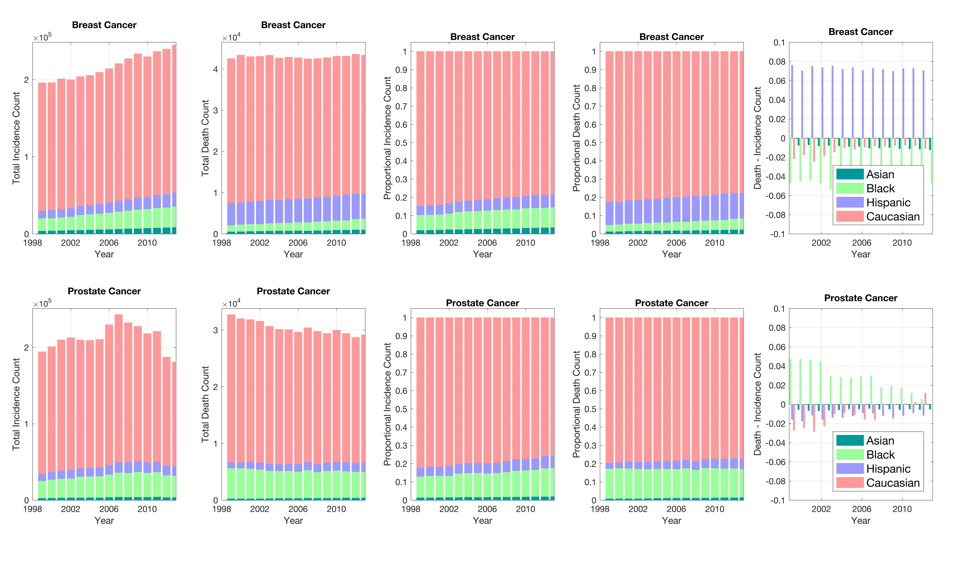
CDC Statistics on Incidence and Death Counts. Proportionally, hispanic patients have comprised 6-8% more of the breast cancer death count than incidence count since 1999. Black patients comprise 1-4% more of the prostate cancer death count than incidence count since 1999.

Slide 40
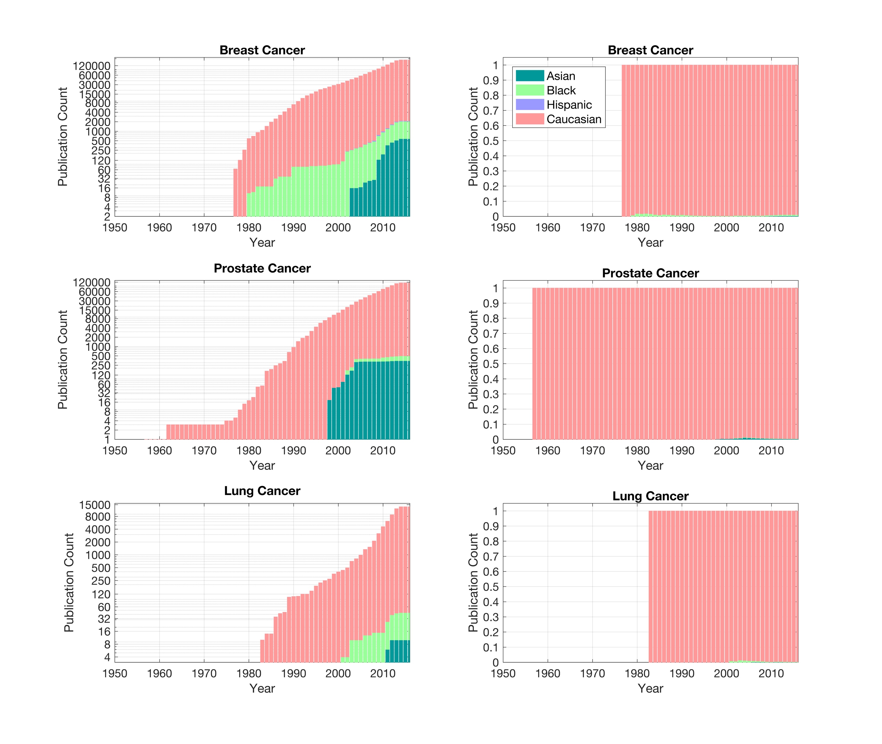
Representation in Published Research Overwhelmingly Caucasian is represented, how does the proportion compare to the incidence and death counts for each cancer type?

